Slide 1
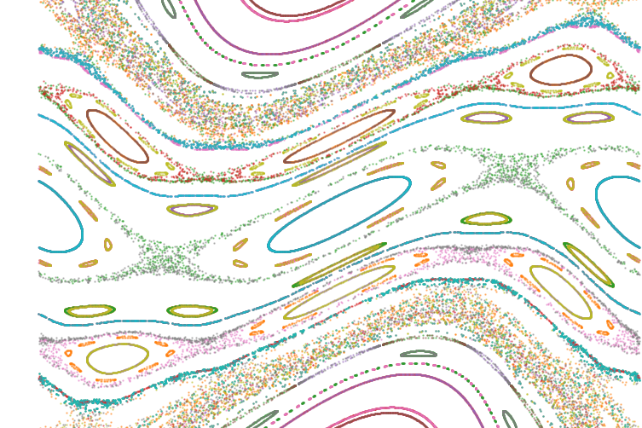
Using Meiss’s action principle to quantify stochasticity in the stellarator edge
Ecole Polytechnique Fédérale de Lausanne
June 2024
Ludovic Rais
Notes:
Thanks a lot Bob for the introduction. Hello everyone, I hope you are having a good day so far, I am really pleased to present my work to you today and I hope you’ll find it of your interest. So, without further adou let’s jump into it.

Slide 2
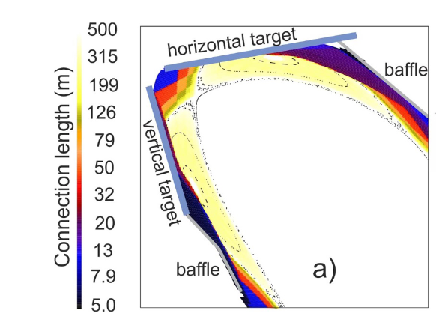
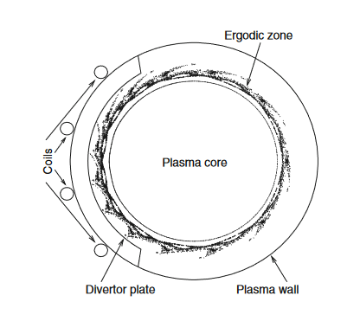
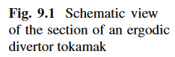
There are different divertor concepts with more or less chaos
Island divertor
The magnetic edge structure relates to the strike points, thus the heat flux, on divertor
Island/Resonant divertors, use low order islands, sensitive to the iota profile
Non-resonant divertor ? Trough regions
Ergodic divertor, creating controled chaos in the edge (TEXTOR, WEST)
Feng and W7-X-team, ‘Review of Magnetic Islands from the Divertor Perspective and a Simplified Heat Transport Model for the Island Divertor’.
NRDs ?
Abdullaev, Magnetic Stochasticity in Magnetically Confined Fusion Plasmas. Ch.9.1
Ergodic divertor
Notes:
In a reactor configuration, to withstand the heat exhaust, we need a divertor concept. The edge magnetic structure is important because it has an impact on (could even say impose) the striking pattern on the divertor plates, and thus the heat flux intensity pattern as well.
There are different types of divertor concepts investigated, which have more or less chaos intresicly :
Island divertor, here on the top right. Create a low order Island. It is sensitive to the iota profile.
Ergodic divertor generate chaos in the edge in a control manner. Note that this has been found to help mitigate ELMs in Tokamk H-mode, maybe if a stellarator H-mode is a thing in the future.
And then you have NRD, some what in between I think. Which i think guys and girls are working, and now much more than I do.
The point I want to enphazise here, is that for some of ergodic be chaotic and island not for instance, and actually there is a spectrum between no chaos at all and a lot of chaos in the edge.
Metric to quantify this chaos

Slide 3
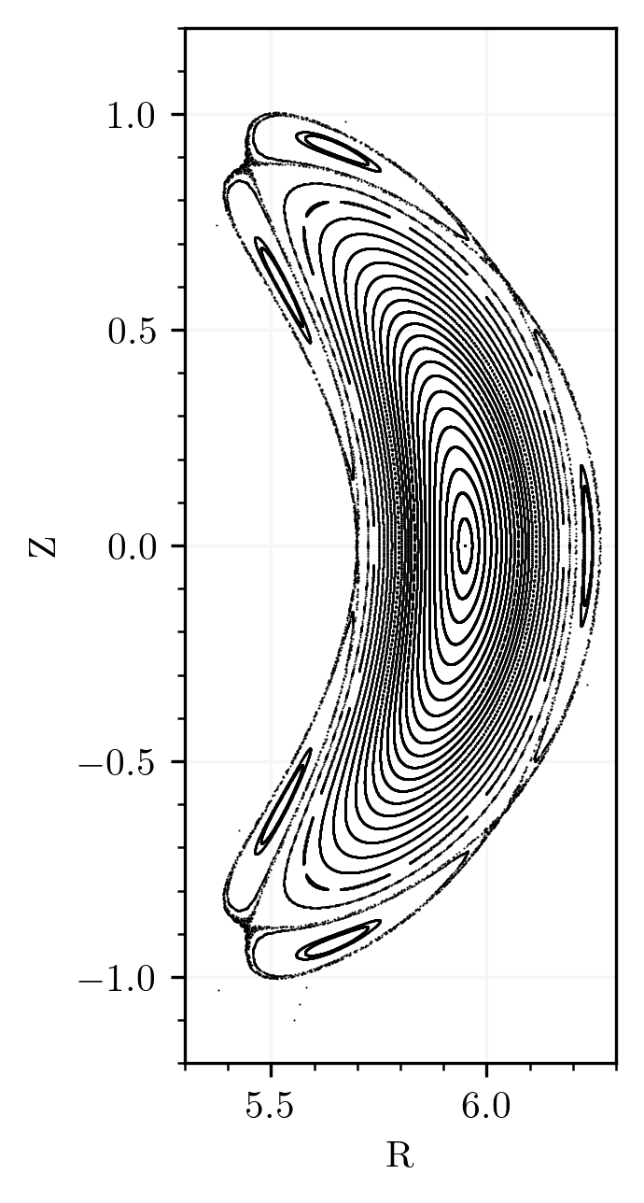
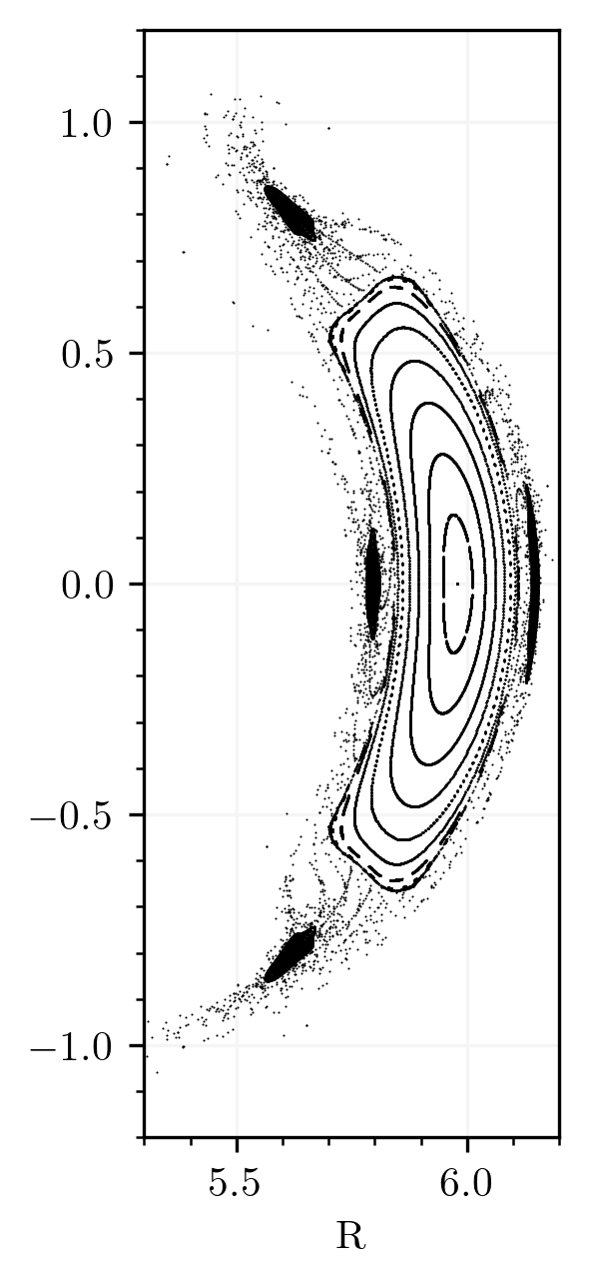
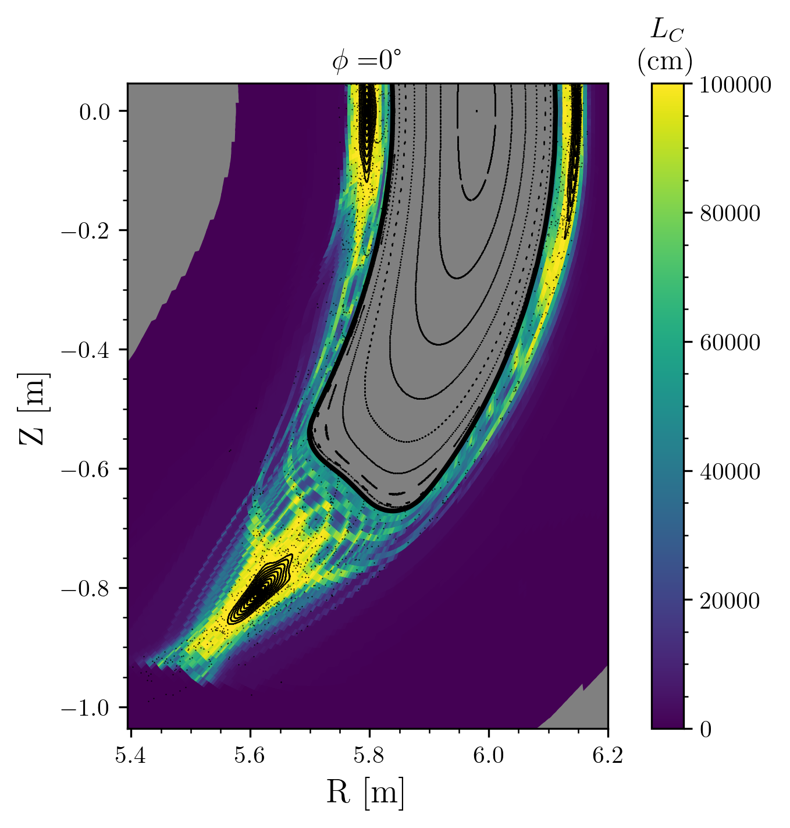
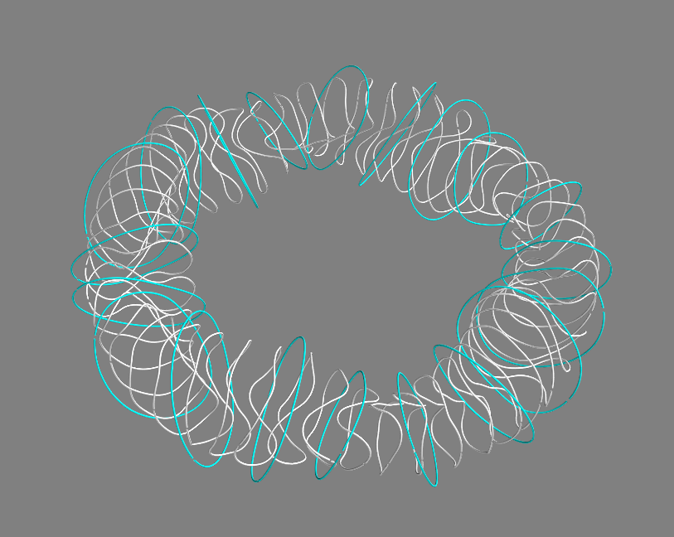
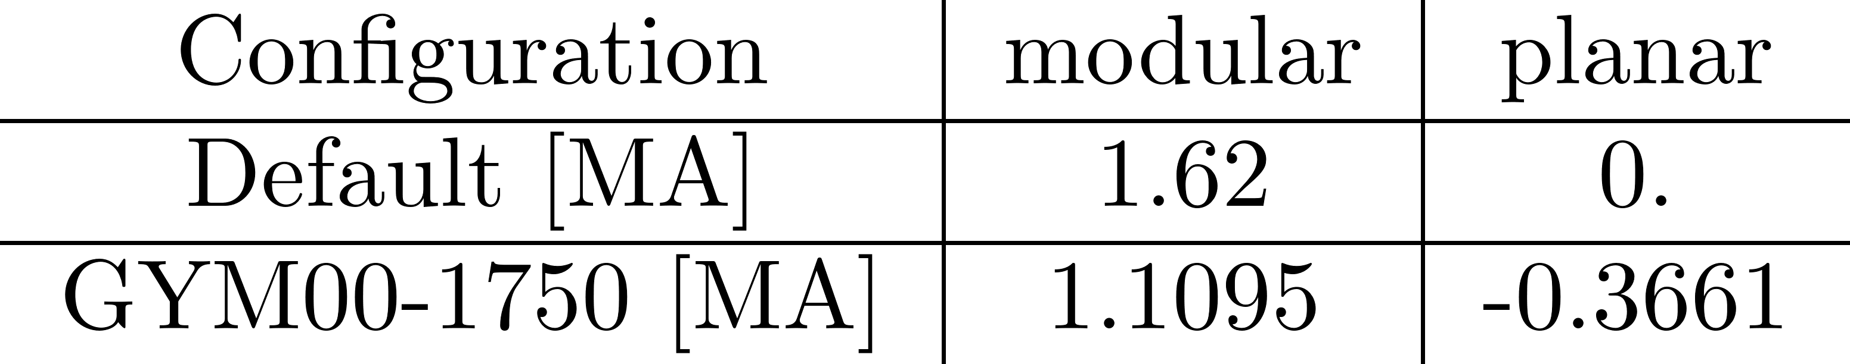
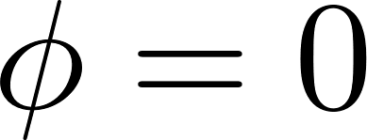
Chaotic configurations in W7X revealed by tweaking the currents
Default
GYM00-1750
Default configuration :
5/5 island chain and is representative of a resonant divertor concept
GYM00-1750 (Robert Davies) :
Chaotic edge and a 5/4 island explores the non-resonant divertor concept.
The current values for modular and planar coils are
How to quantify the stochasticity in the edge ?
Robert Davies
Notes:
For instance in W7X :
There is the default configuration with the beautiful 5/5 island chain
But you can kick it into chaos
Looking at a connection length plot of the edge ; EMC3 (-lite), I think here it is the minimum connection length between forward and backward tracing.
We see the interesting edge structure.
The question is are we able to quantify the Chaos here and maybe explain this intertwined edge structure ?

Slide 4
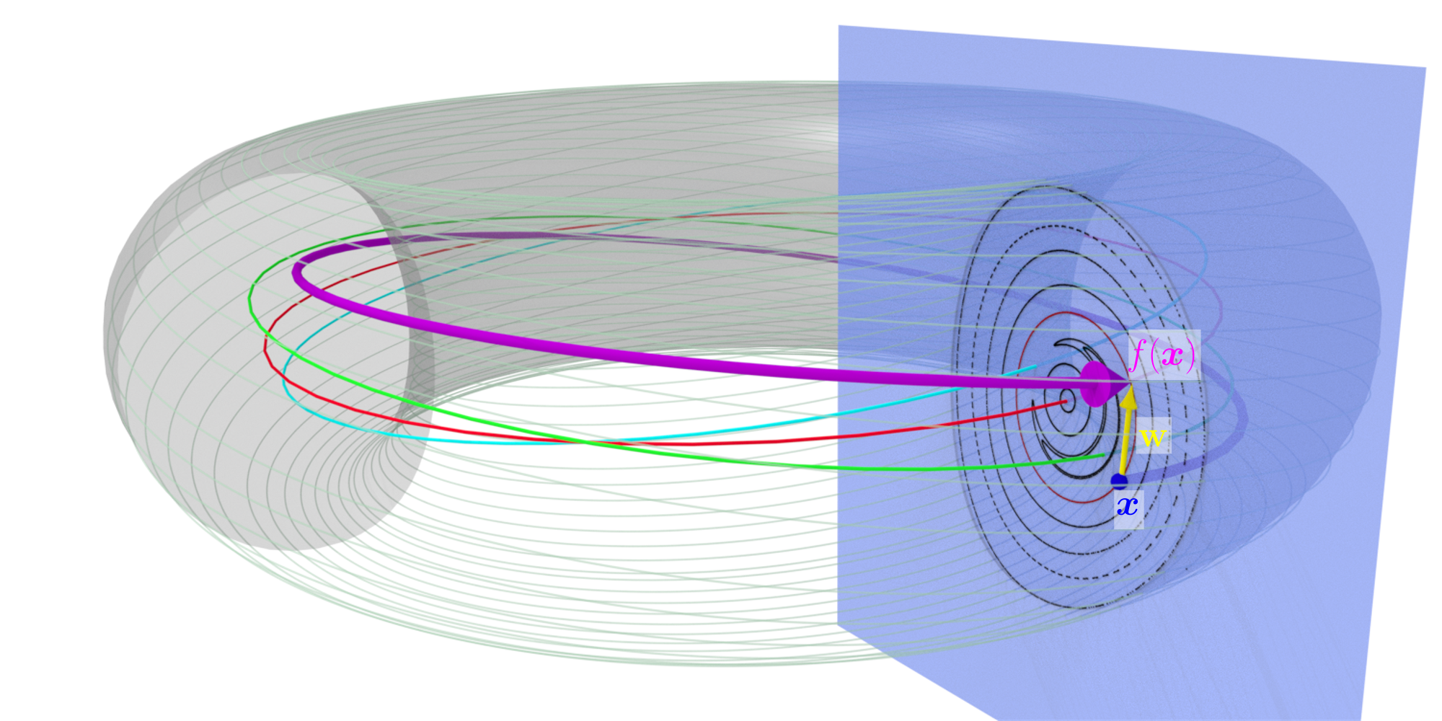
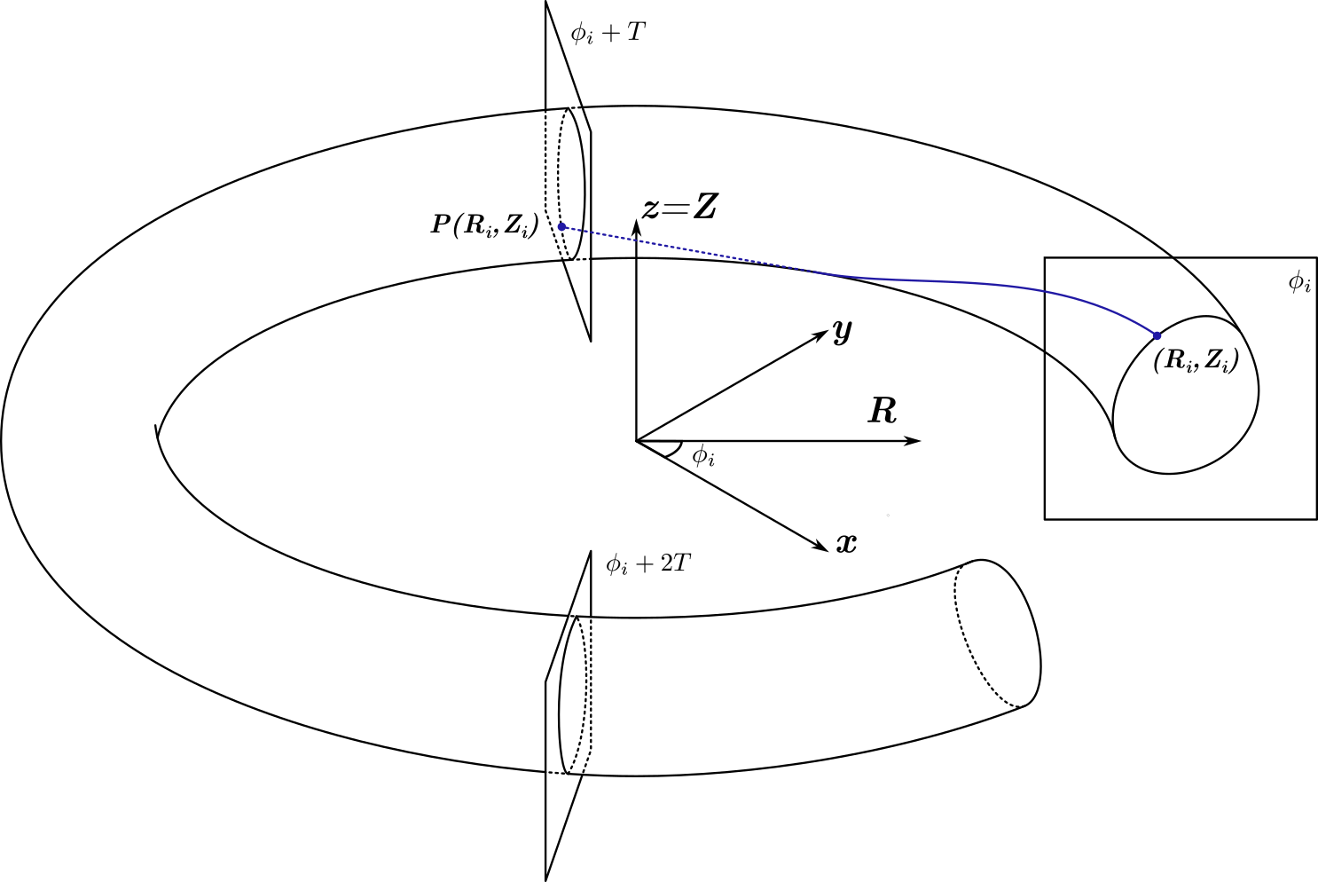
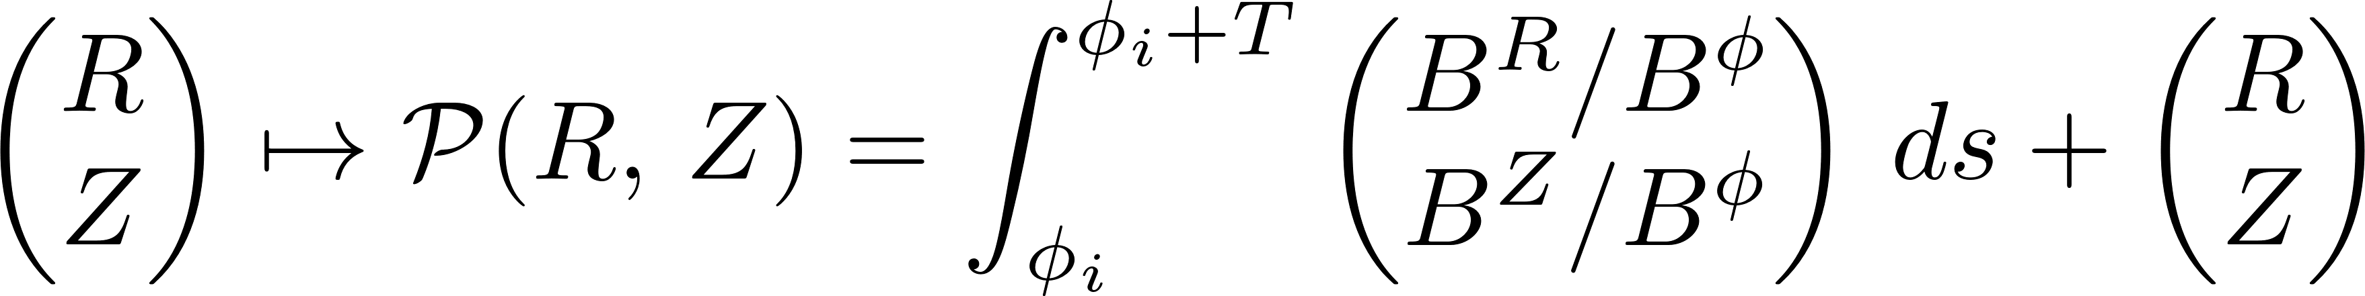
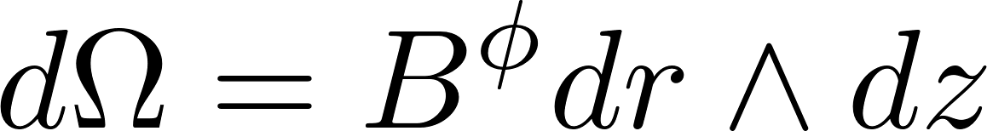
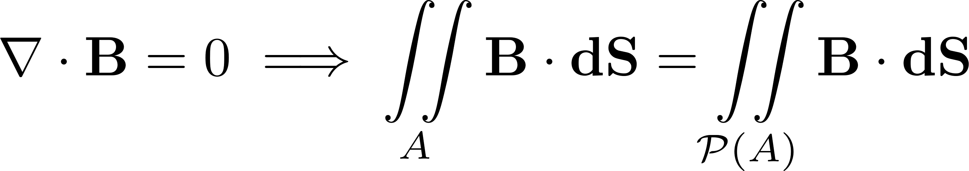
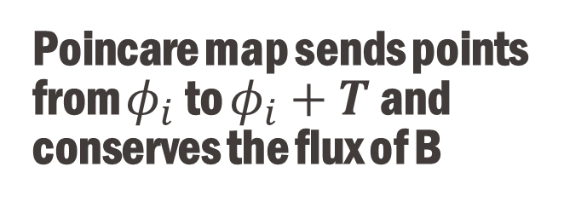
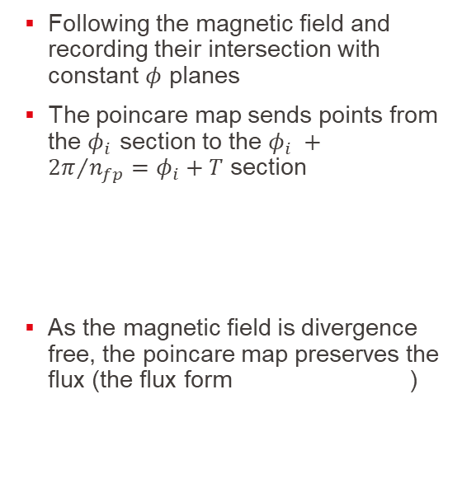
Poincare map sends points from $φ_{i}$ to $φ_{i}+T$ and conserves the flux of B
Smiet, C. B., G. J. Kramer, and S. R. Hudson. "Mapping the sawtooth."
Following the magnetic field and recording their intersection with constant $φ$ planes
The poincare map sends points from the $φ_{i}$ section to the $φ_{i} +{2π}/{n_{fp}=φ_{i}+T}$ section
As the magnetic field is divergence free, the poincare map preserves the flux (the flux form )
Notes:
In order to go that path, we will first need to go back on some definitions.
We will define the poincare map that records the intersection with constant phi plane when you follow the magnetic field around in cylindrical coordinates.
Here need to be careful that B phi is not gong to zero is well defined.
But actually we can use the field periodicity present in stellarator, the poincare section is identical in phi and phi + T.
Using this
One thing to note is that the poincare map is flux preserving due to the divergence free property of the b field

Slide 5
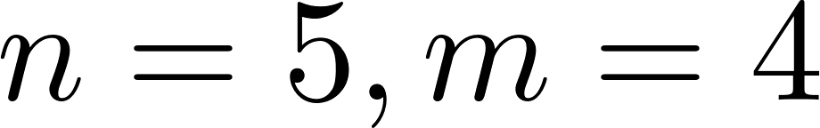
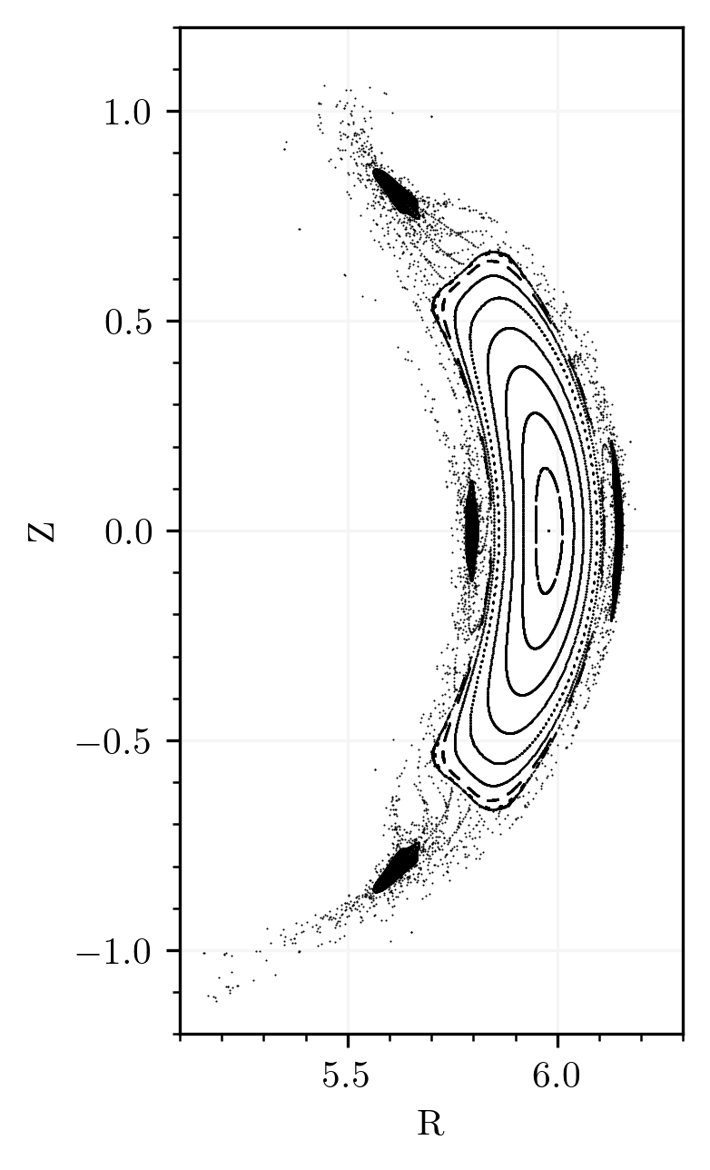
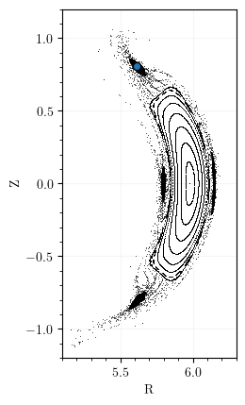
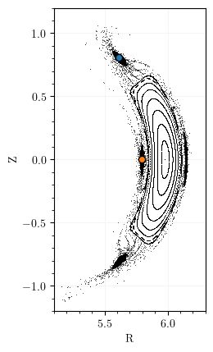
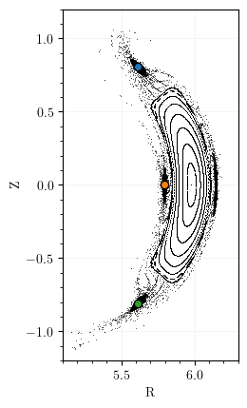

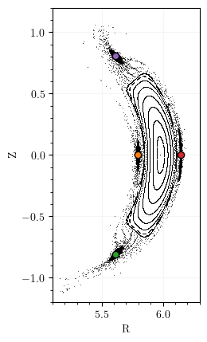

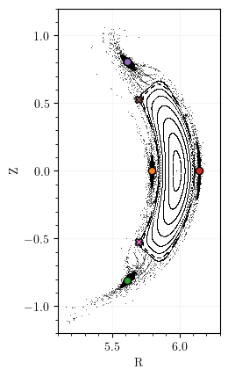

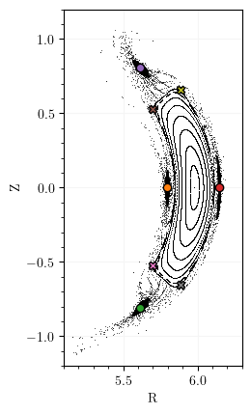
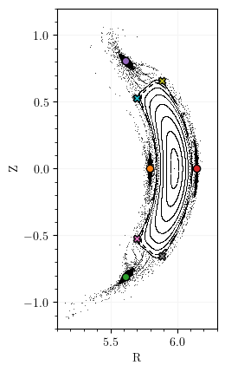
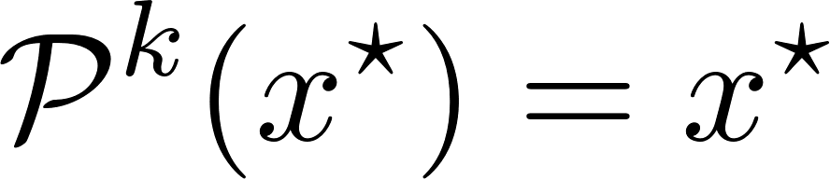
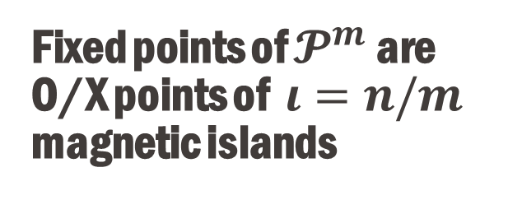
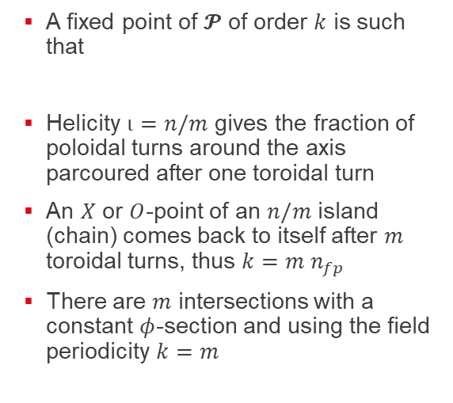
Fixed points of $𝓟^{m}$ are O/X points of $ι=n/m$ magnetic islands
A fixed point of $𝓟$ of order $k$ is such that
Helicity $ι=n/m$ gives the fraction of poloidal turns around the axis parcoured after one toroidal turn
An $X$ or $O$-point of an $n/m$ island (chain) comes back to itself after $m$ toroidal turns, thus $k=m n_{fp}$
There are $m$ intersections with a constant $φ$-section and using the field periodicity $k=m$
Notes:
Now how can we relate the magnetic islands to the poincare map.
So a fixed point of order k of p
Now in the case of an isanld we know we have rationnal iota, here i write iota to be the winding number, we know that it is equal to n over m
With the number n poloidal turns which are parcour after m toroidal turns
So after m toroidal turn you go back
Here the poincare map takes point from a phi section to another phi section

Slide 6
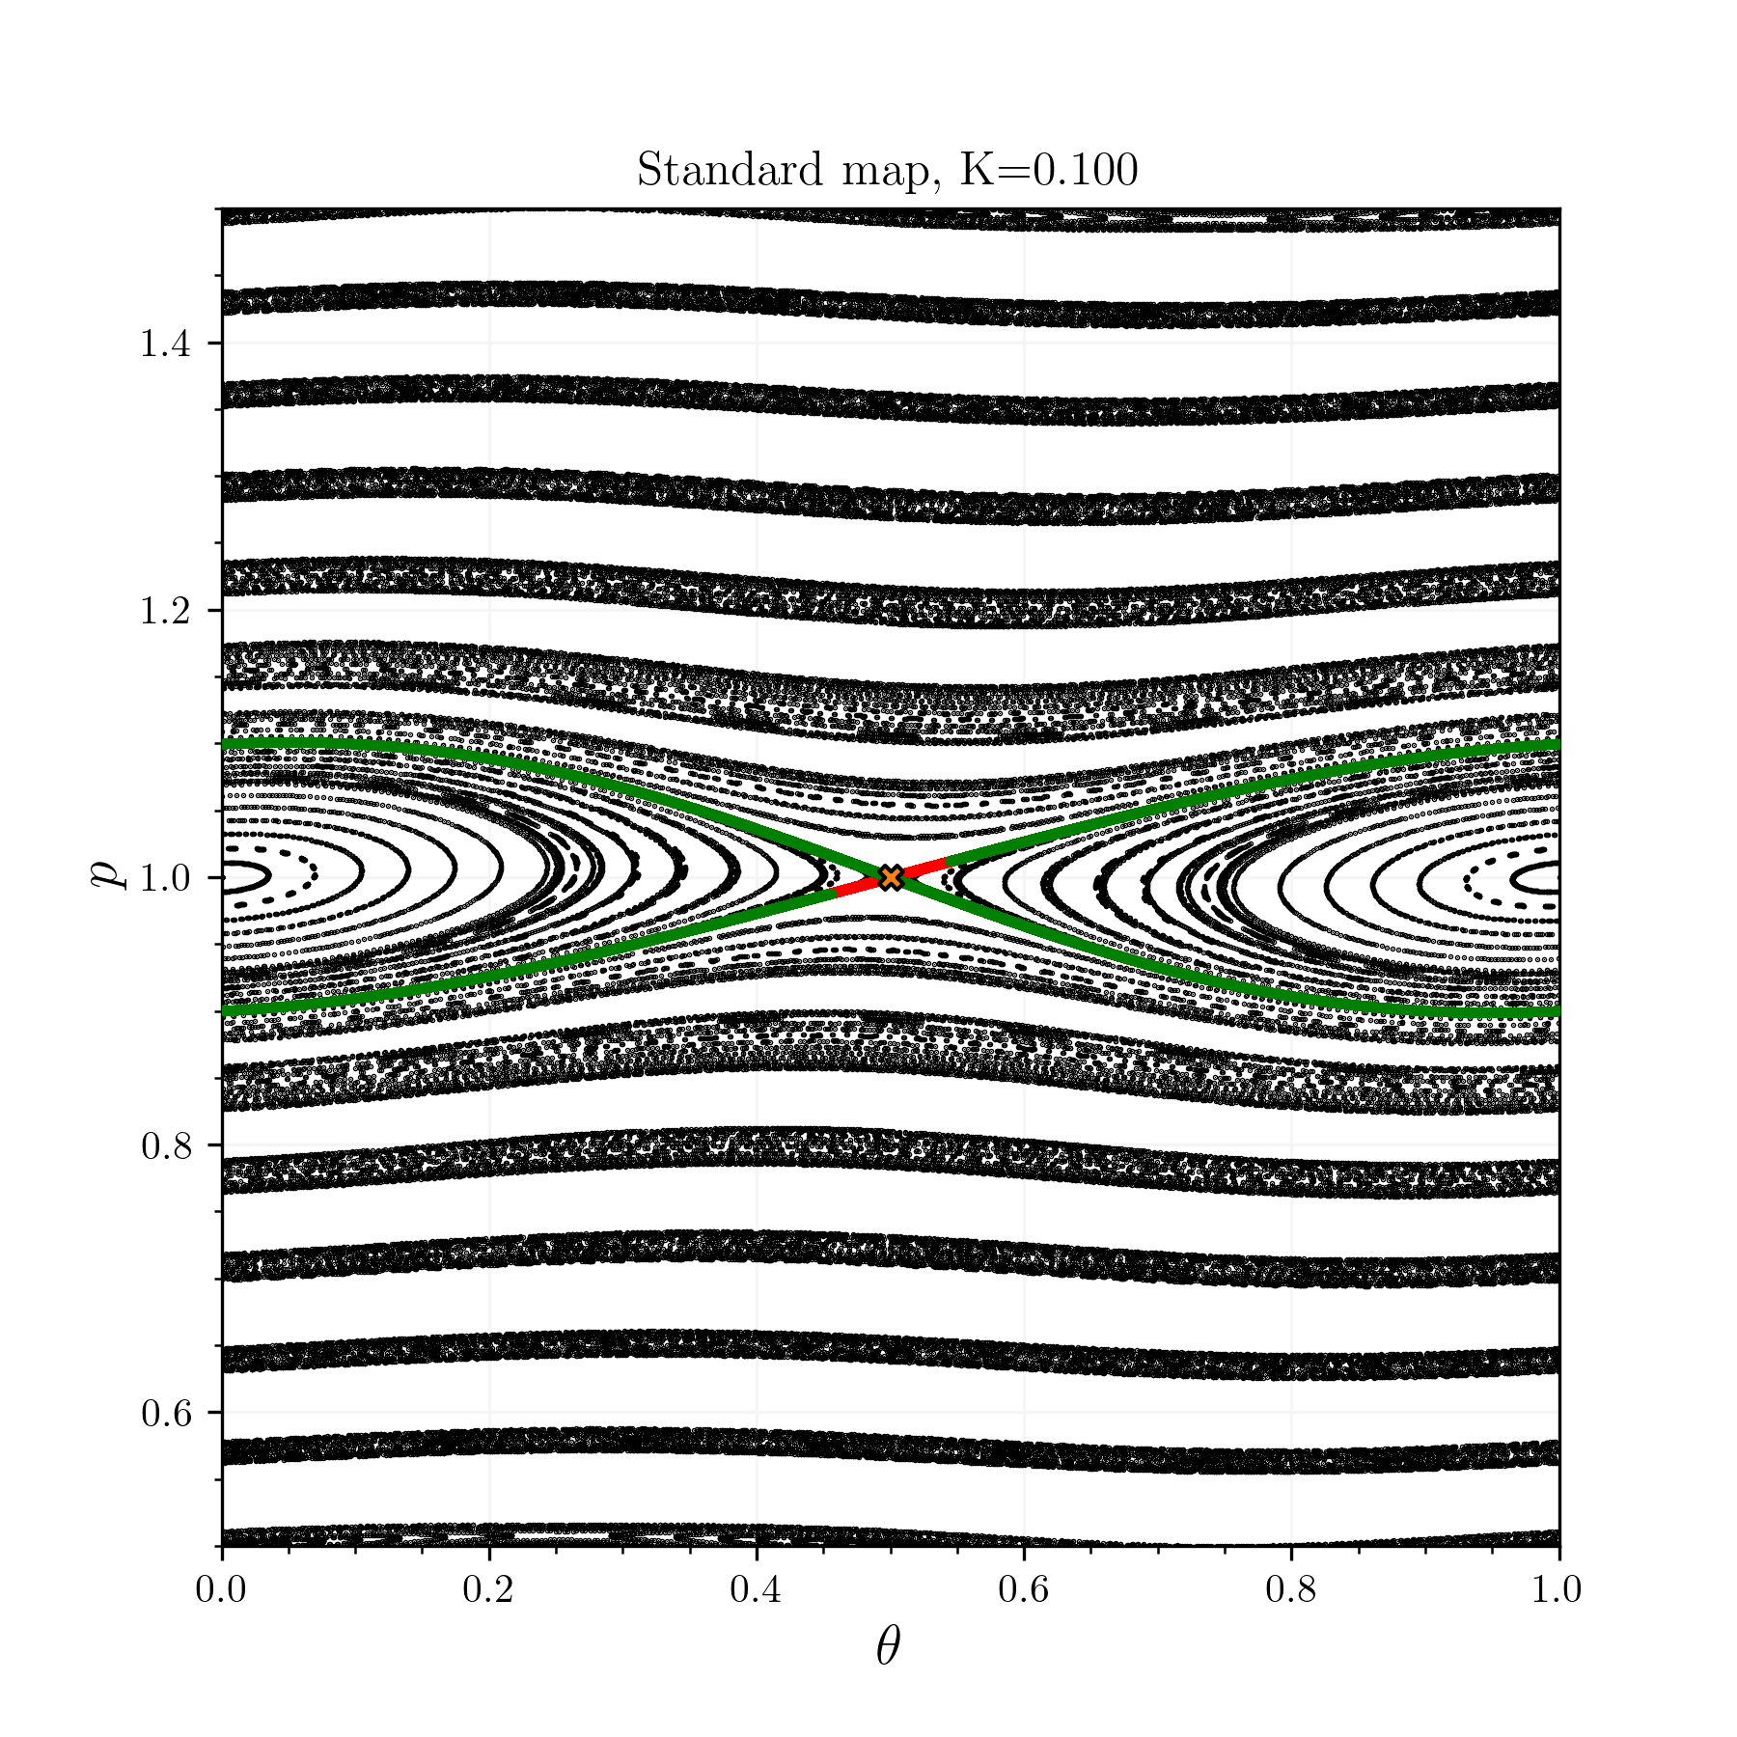
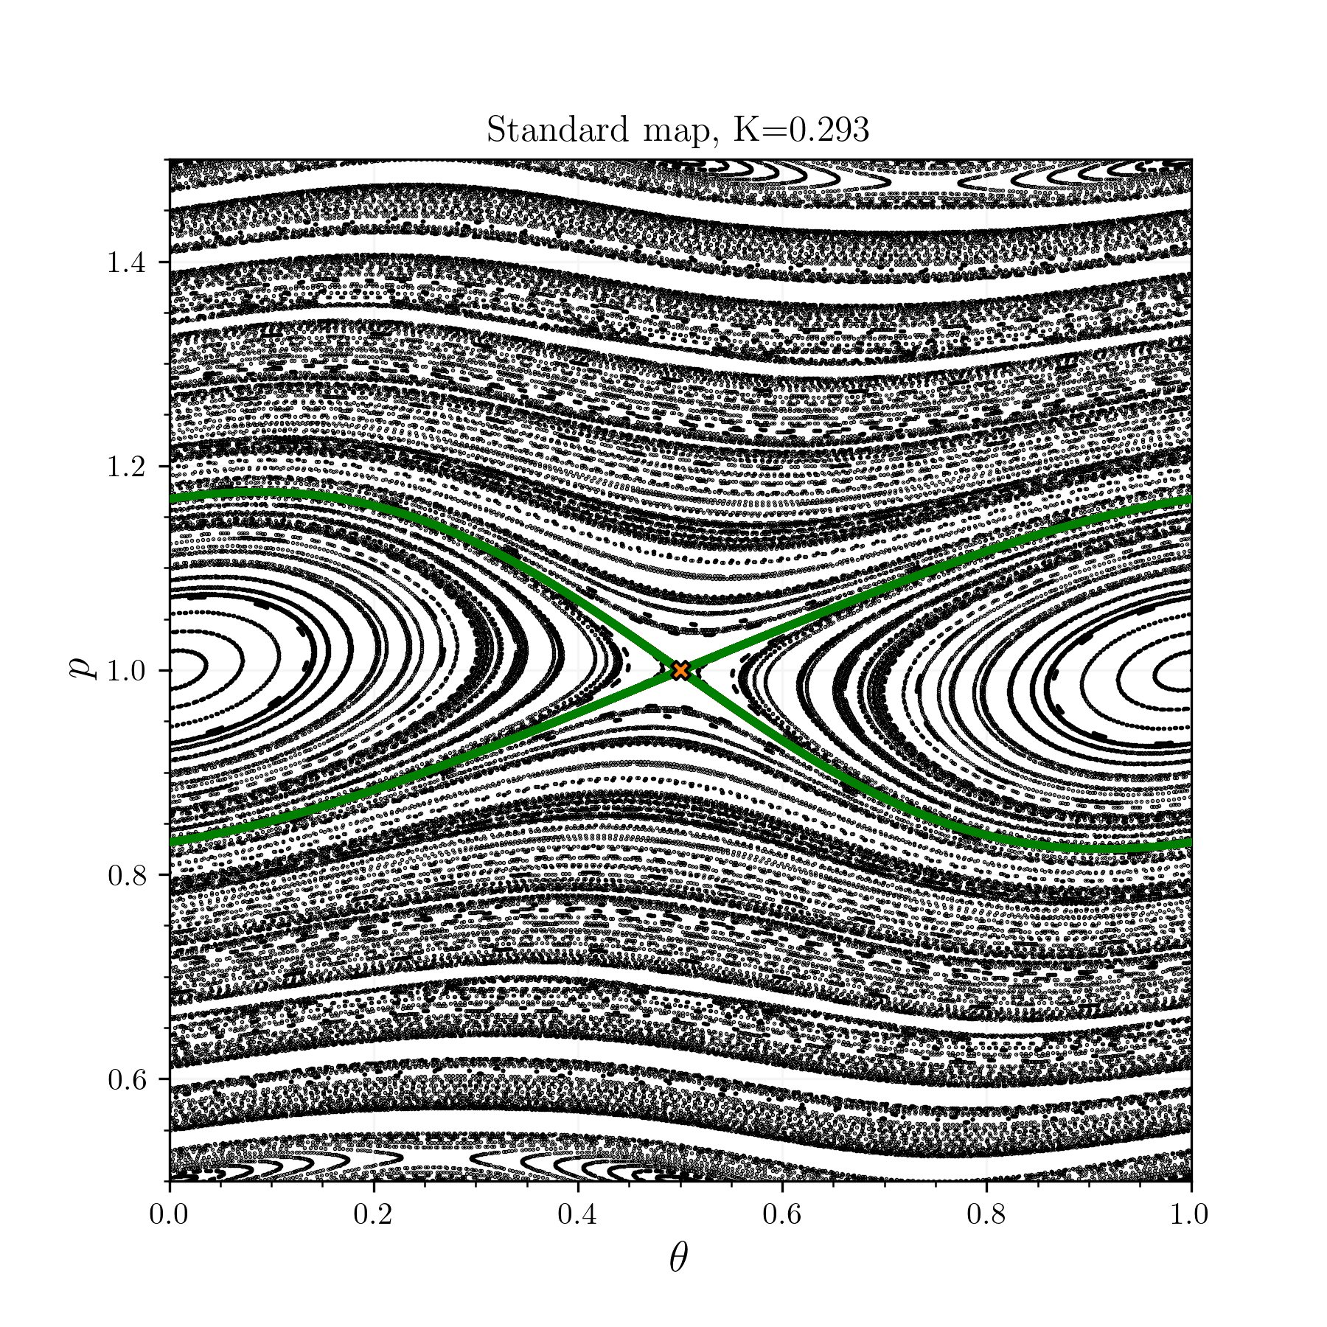
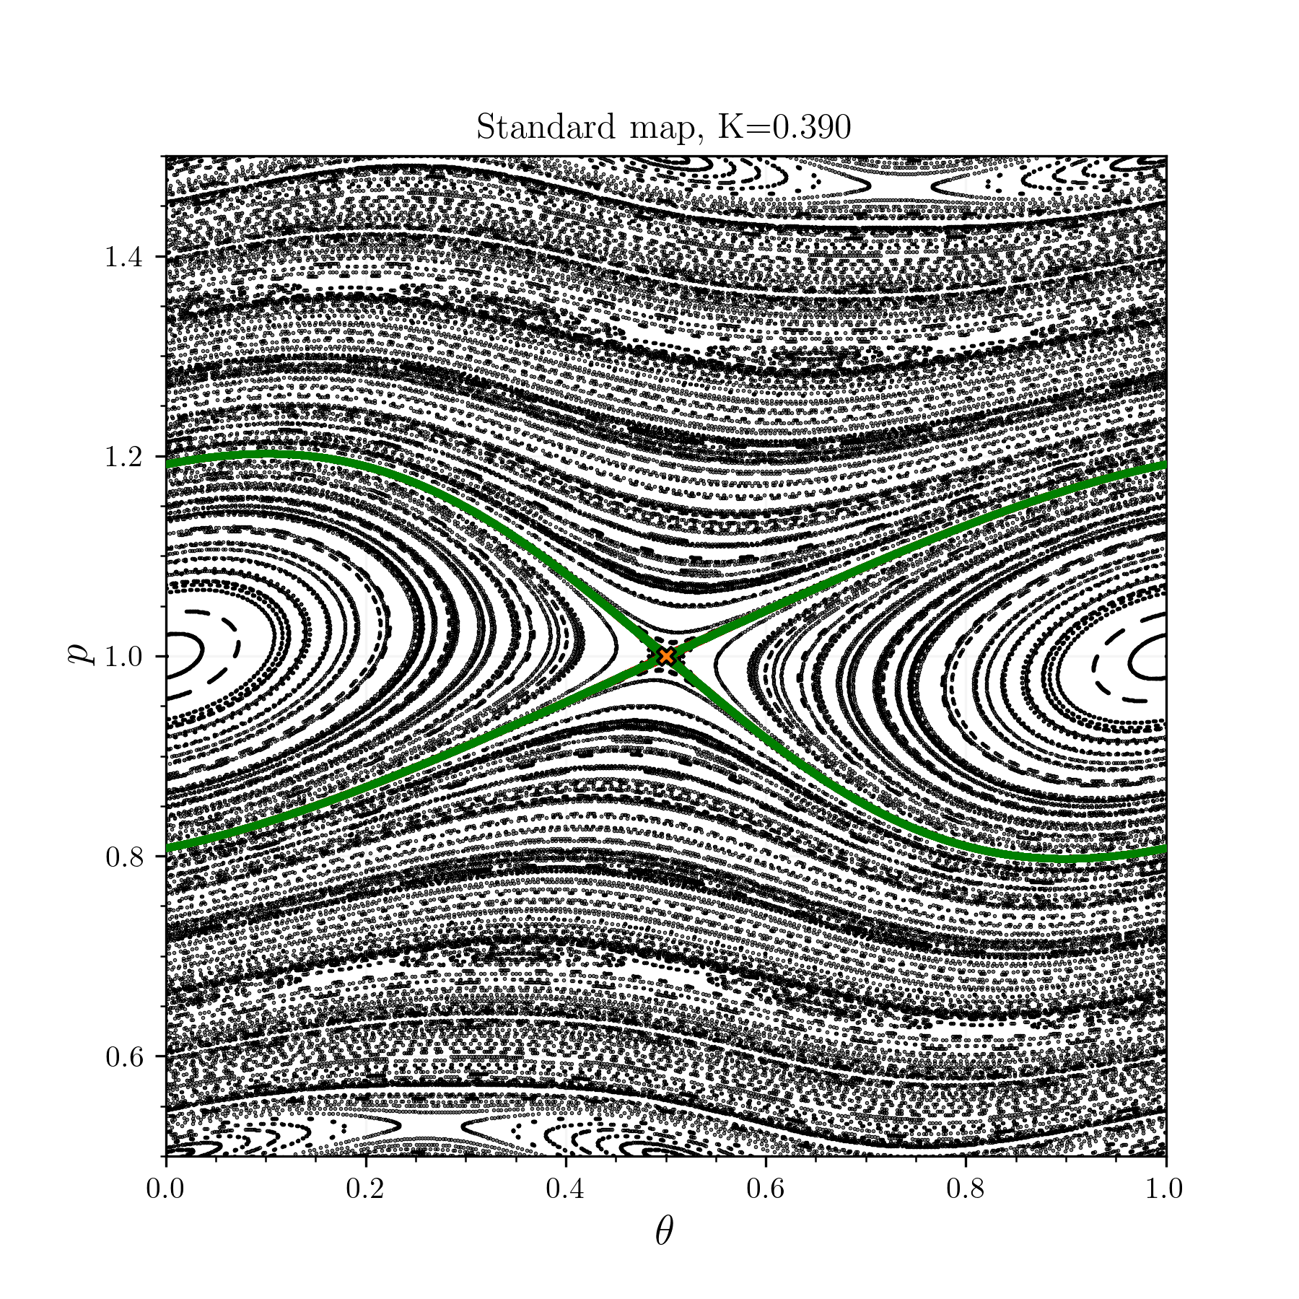
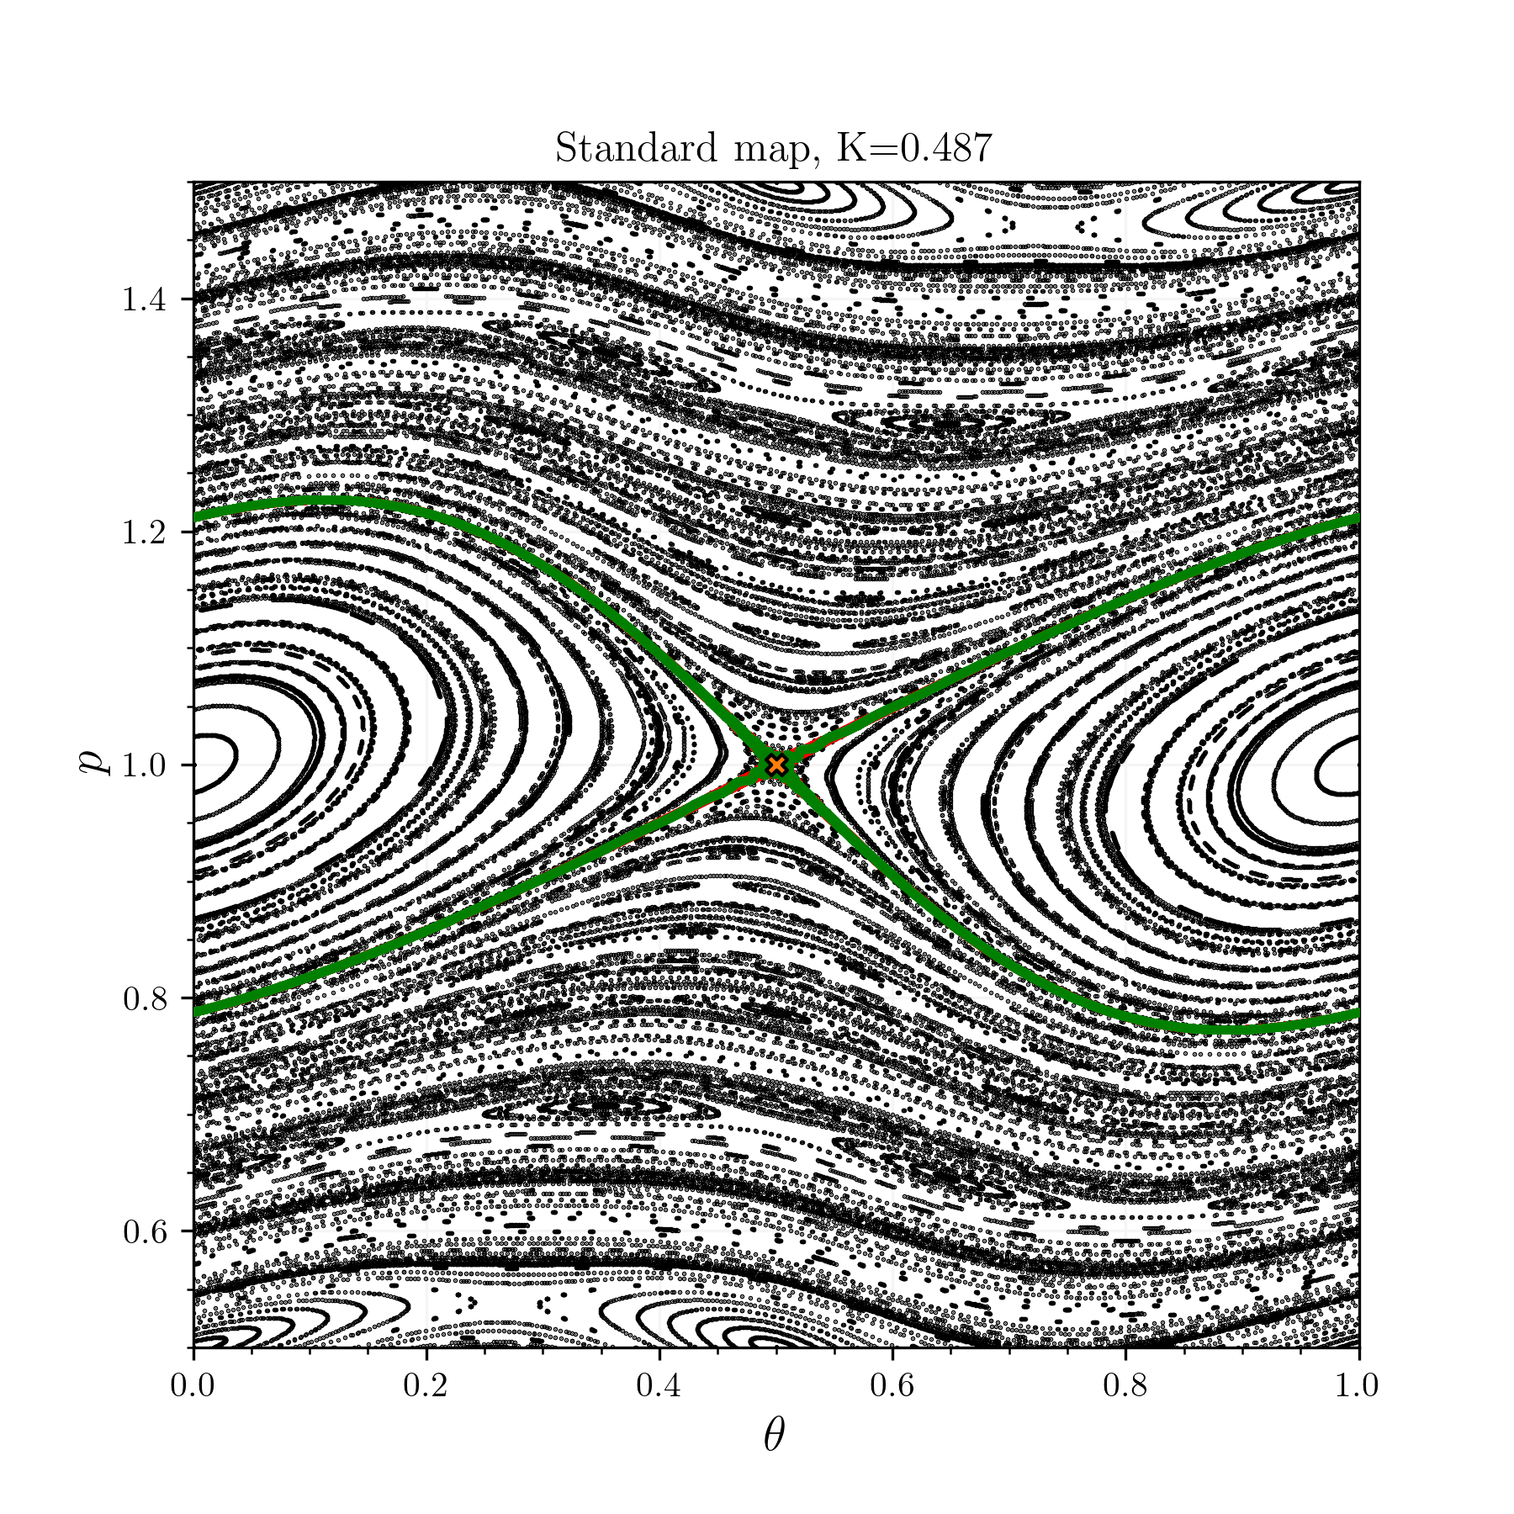
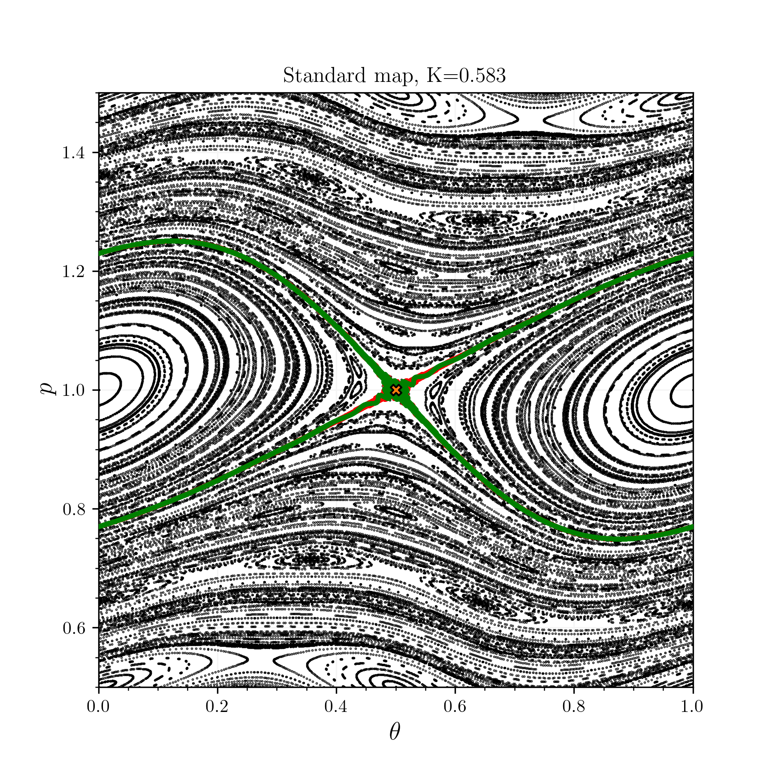
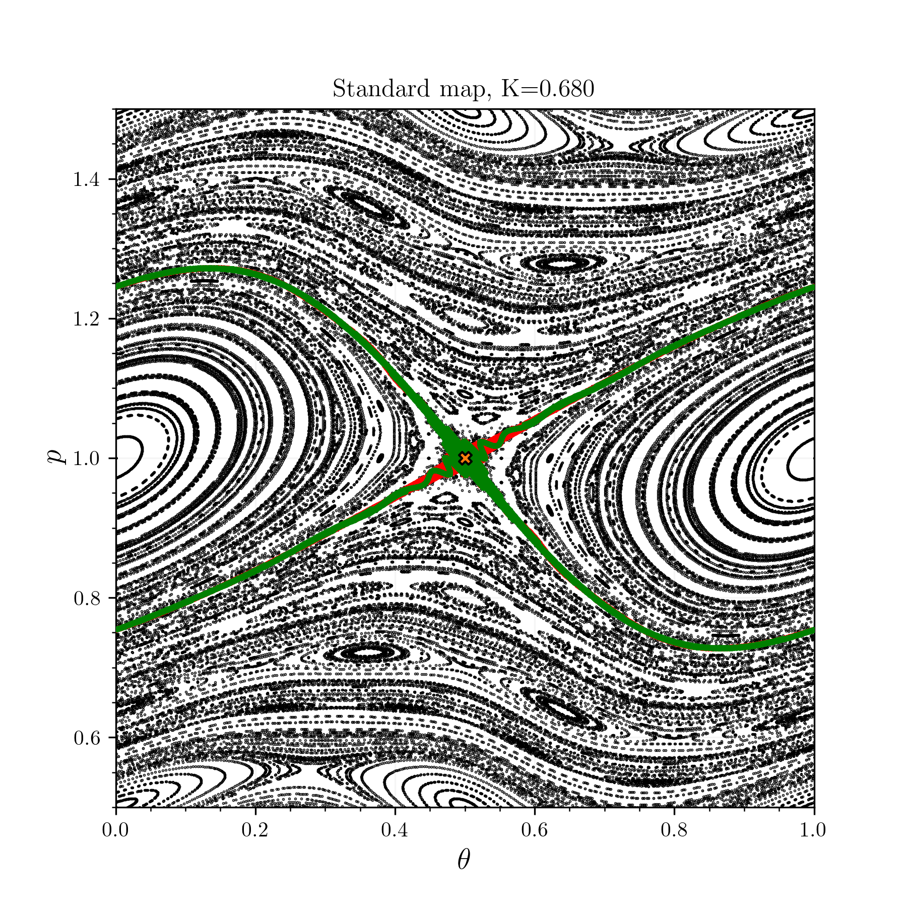
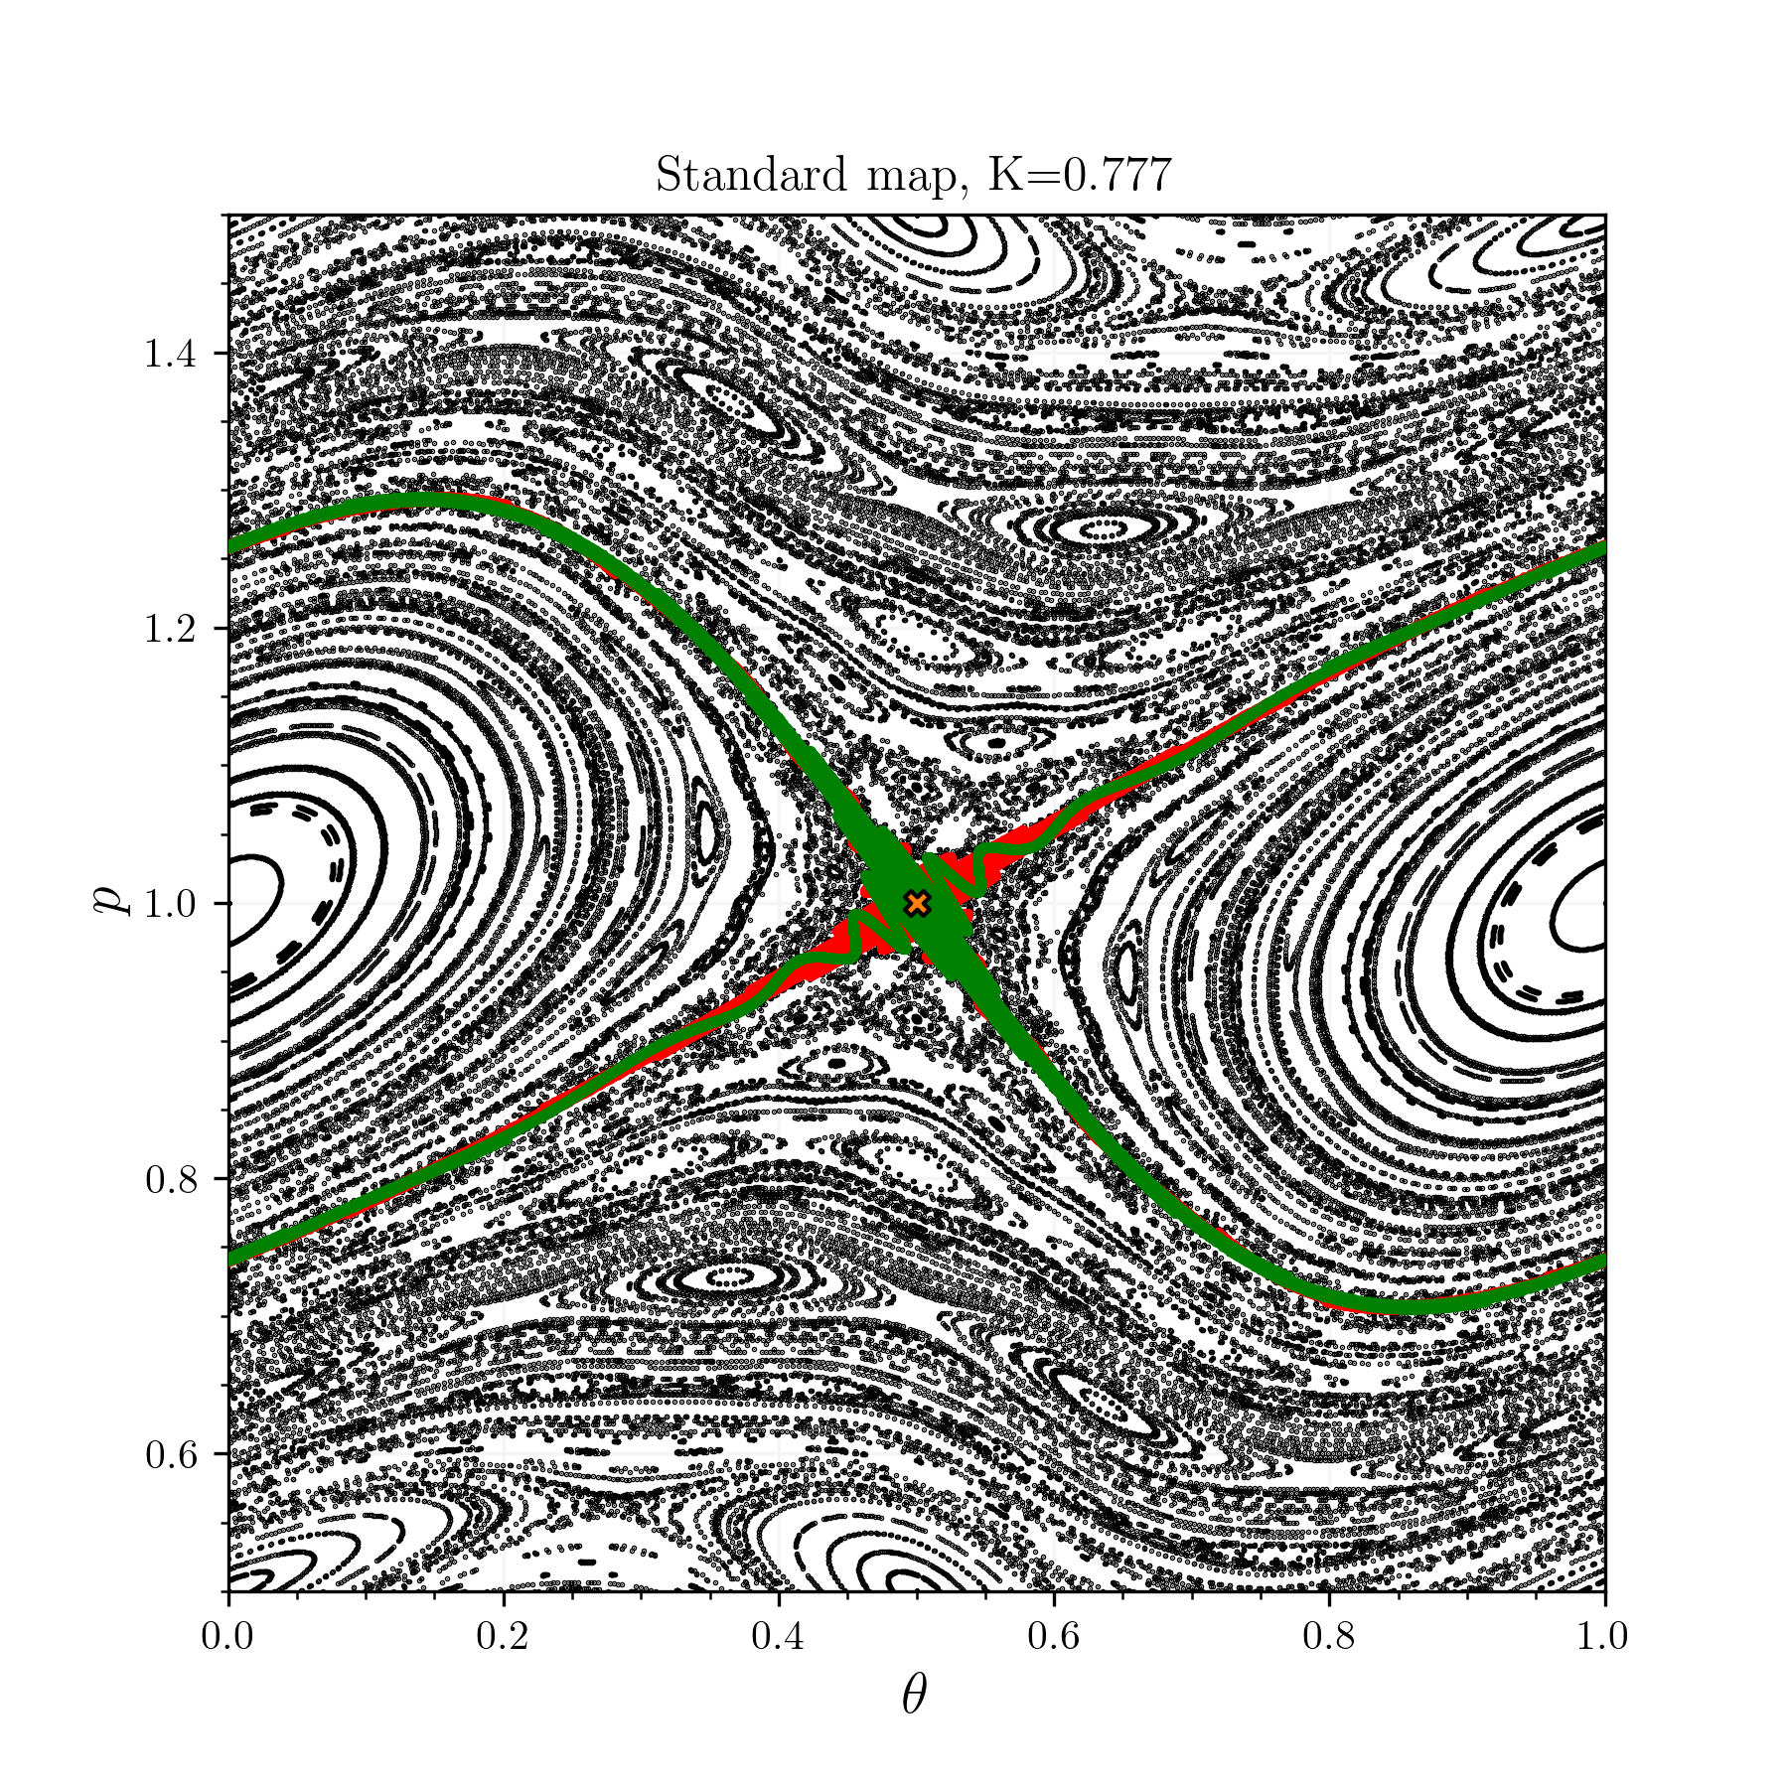
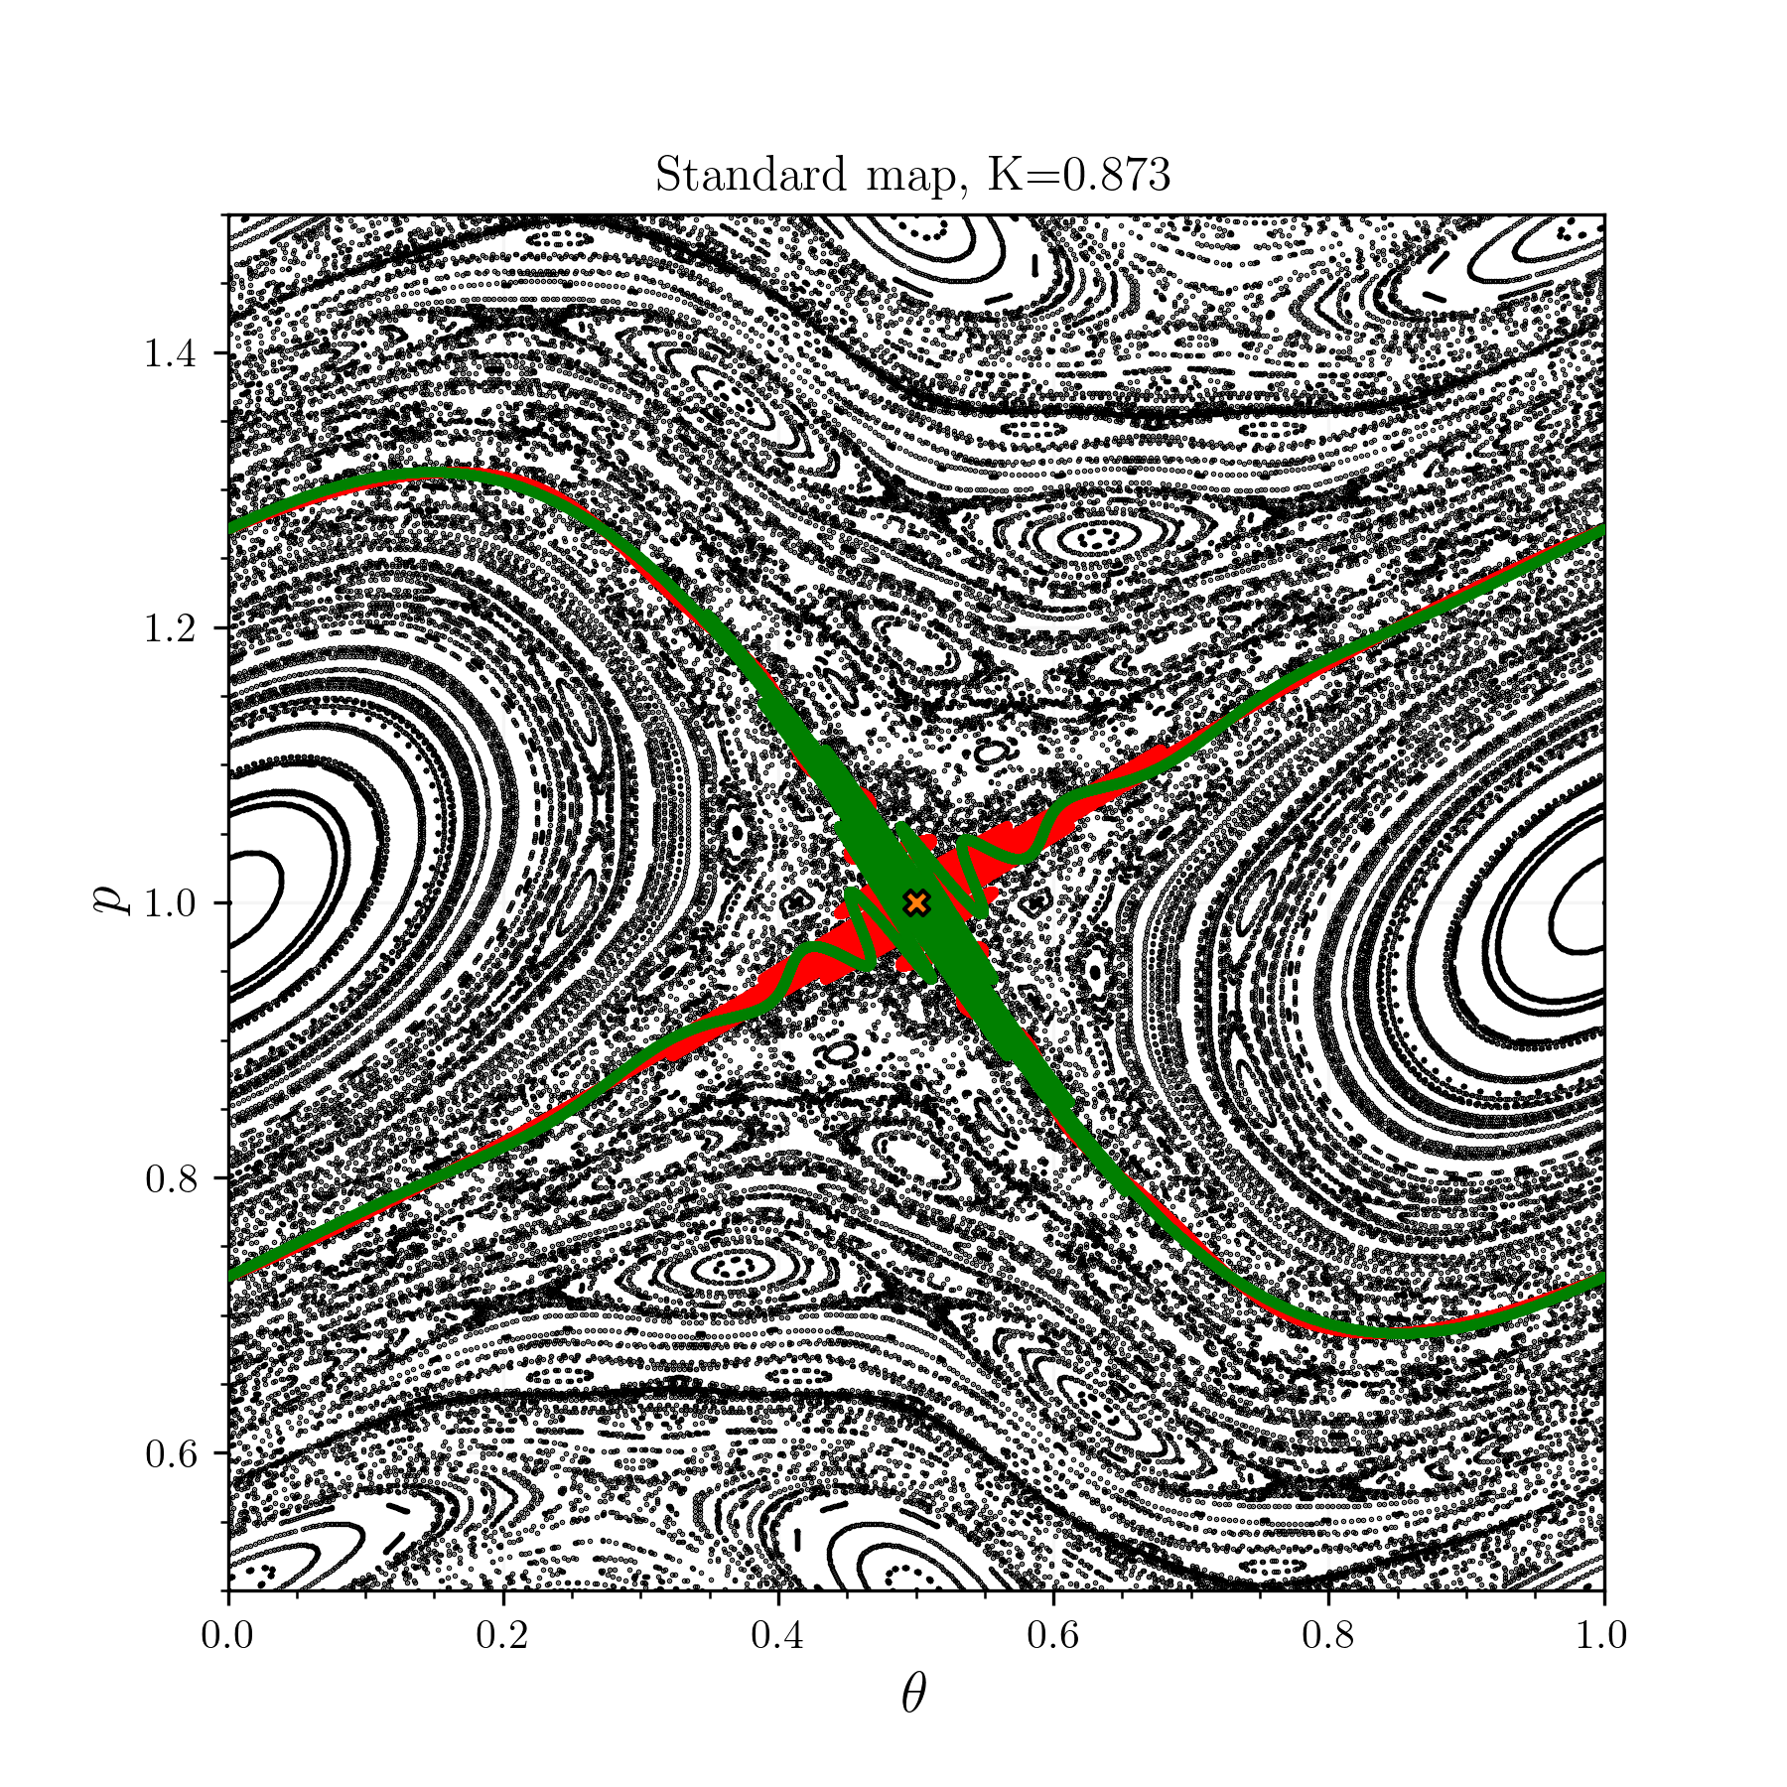
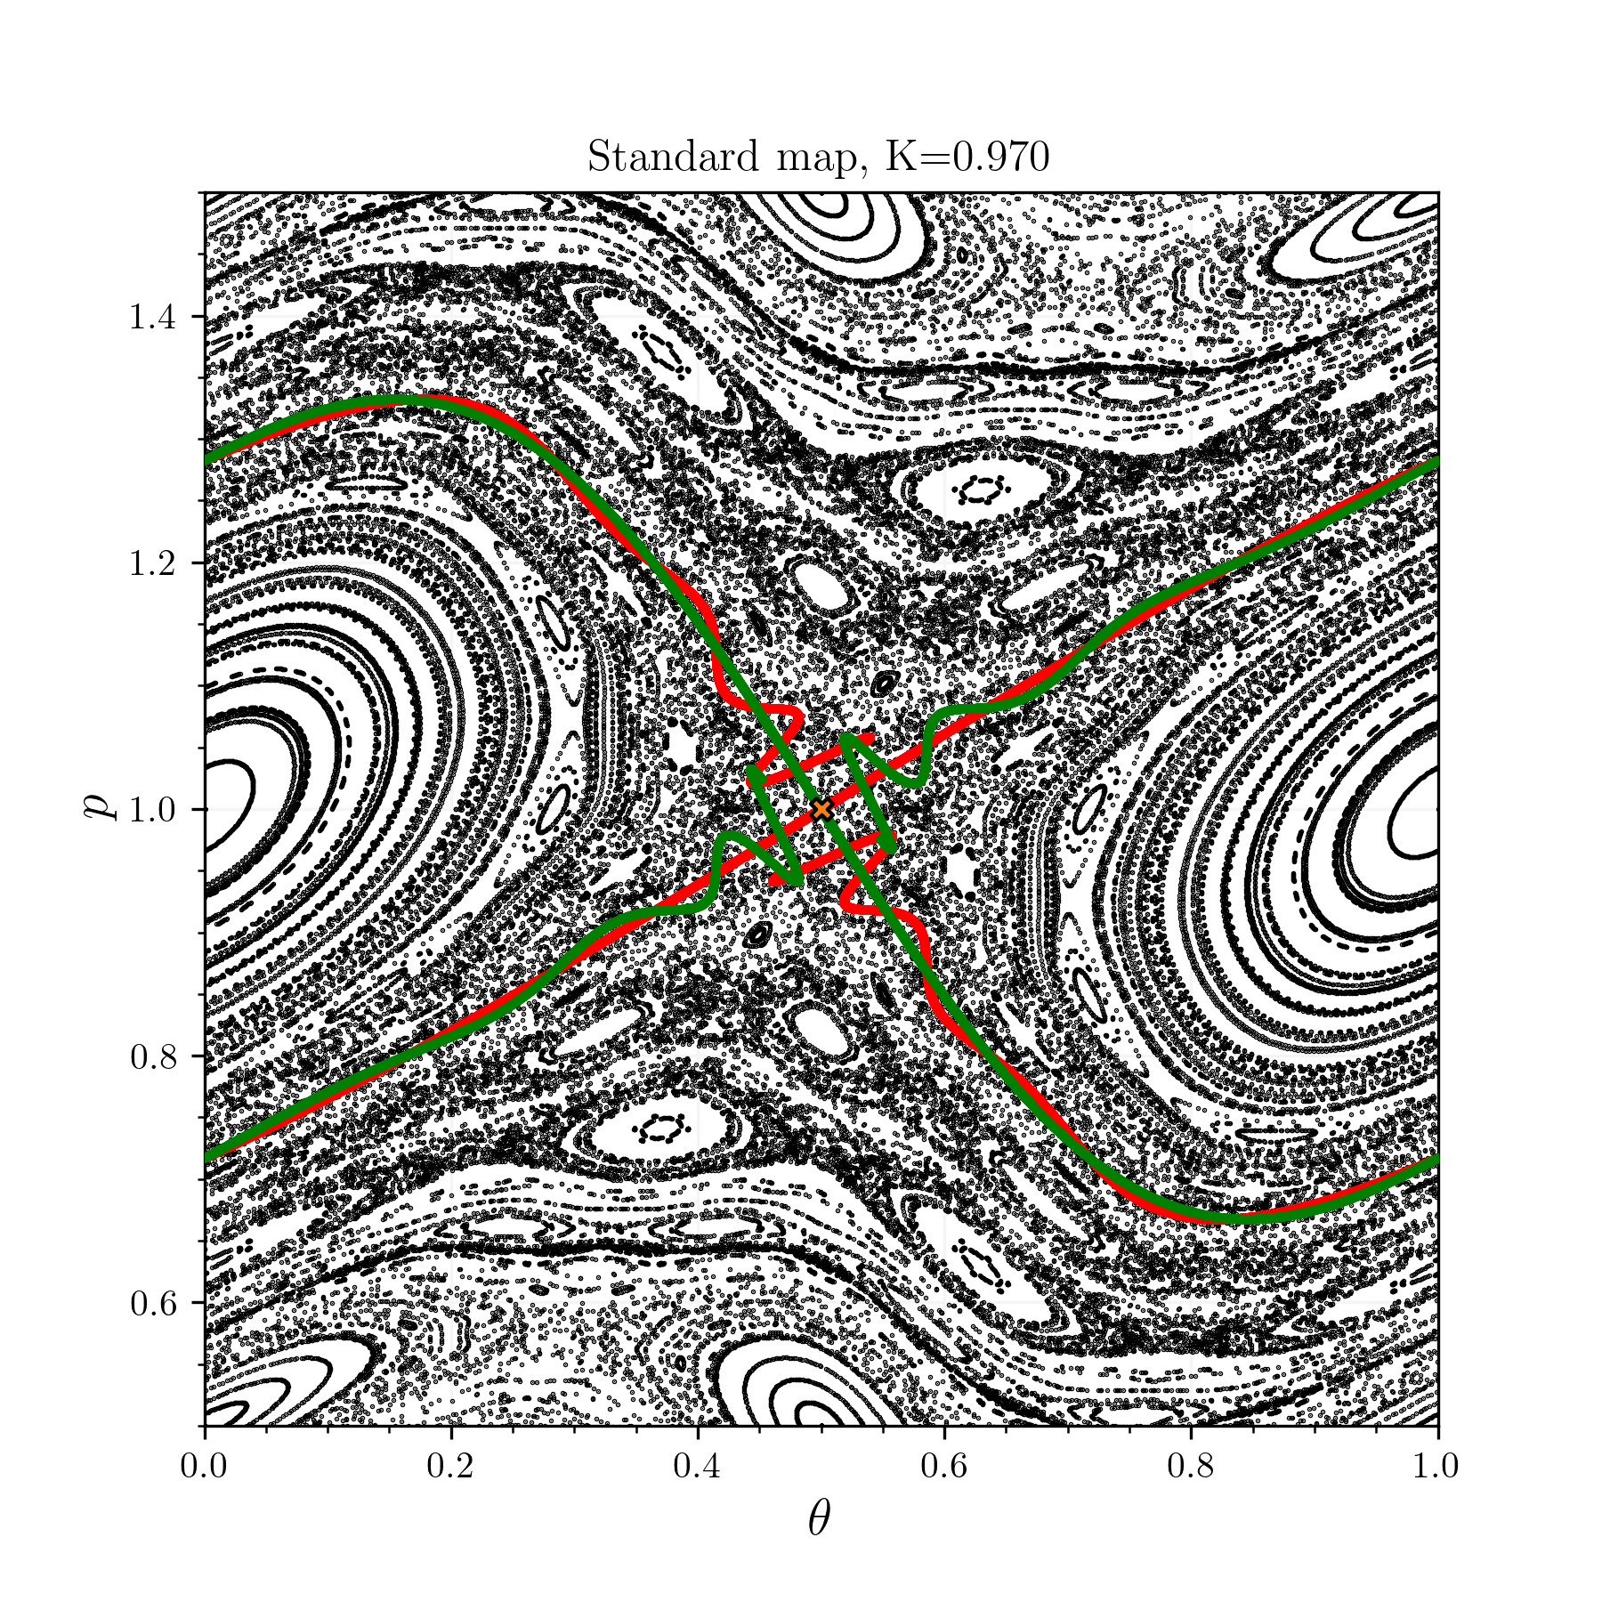
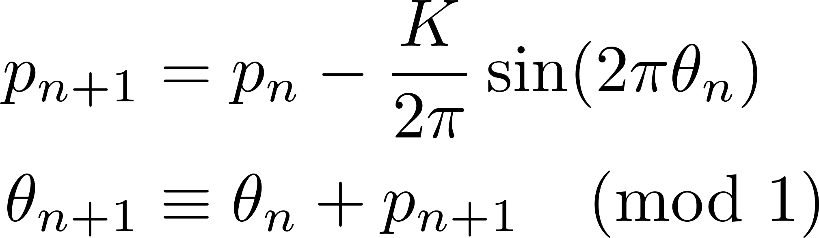
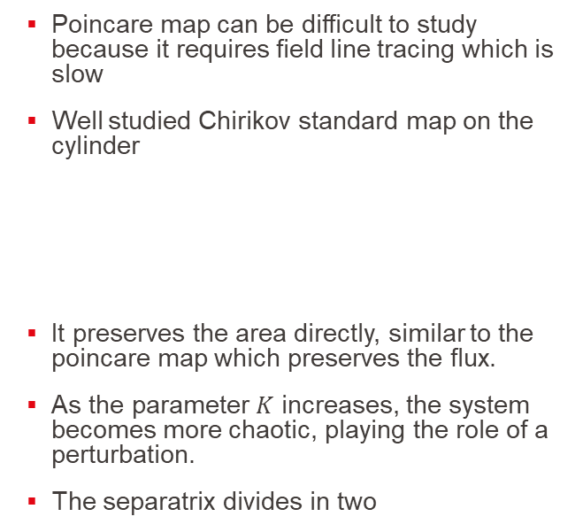
Separatrix of an island can break and indicates Chaos by brokeness
Poincare map can be difficult to study because it requires field line tracing which is slow
Well studied Chirikov standard map on the cylinder
It preserves the area directly, similar to the poincare map which preserves the flux.
As the parameter $K$ increases, the system becomes more chaotic, playing the role of a perturbation.
The separatrix divides in two
Meiss, ‘Thirty Years of Turnstiles and Transport’.
Notes:
Is there an easier model with similar behaviour ?d map them to a next phi section. However we need FLT and it is computationnaly slow to evaluate !!!
Similar behaviour, where the poincare map is flux preserving, the standard map is area preserving (a close surface with will have same area before and after the mapping)
K perturbation
The clean separatrix in the non chaotic splits
As you can see separatrix is related to an X-point.

Slide 7
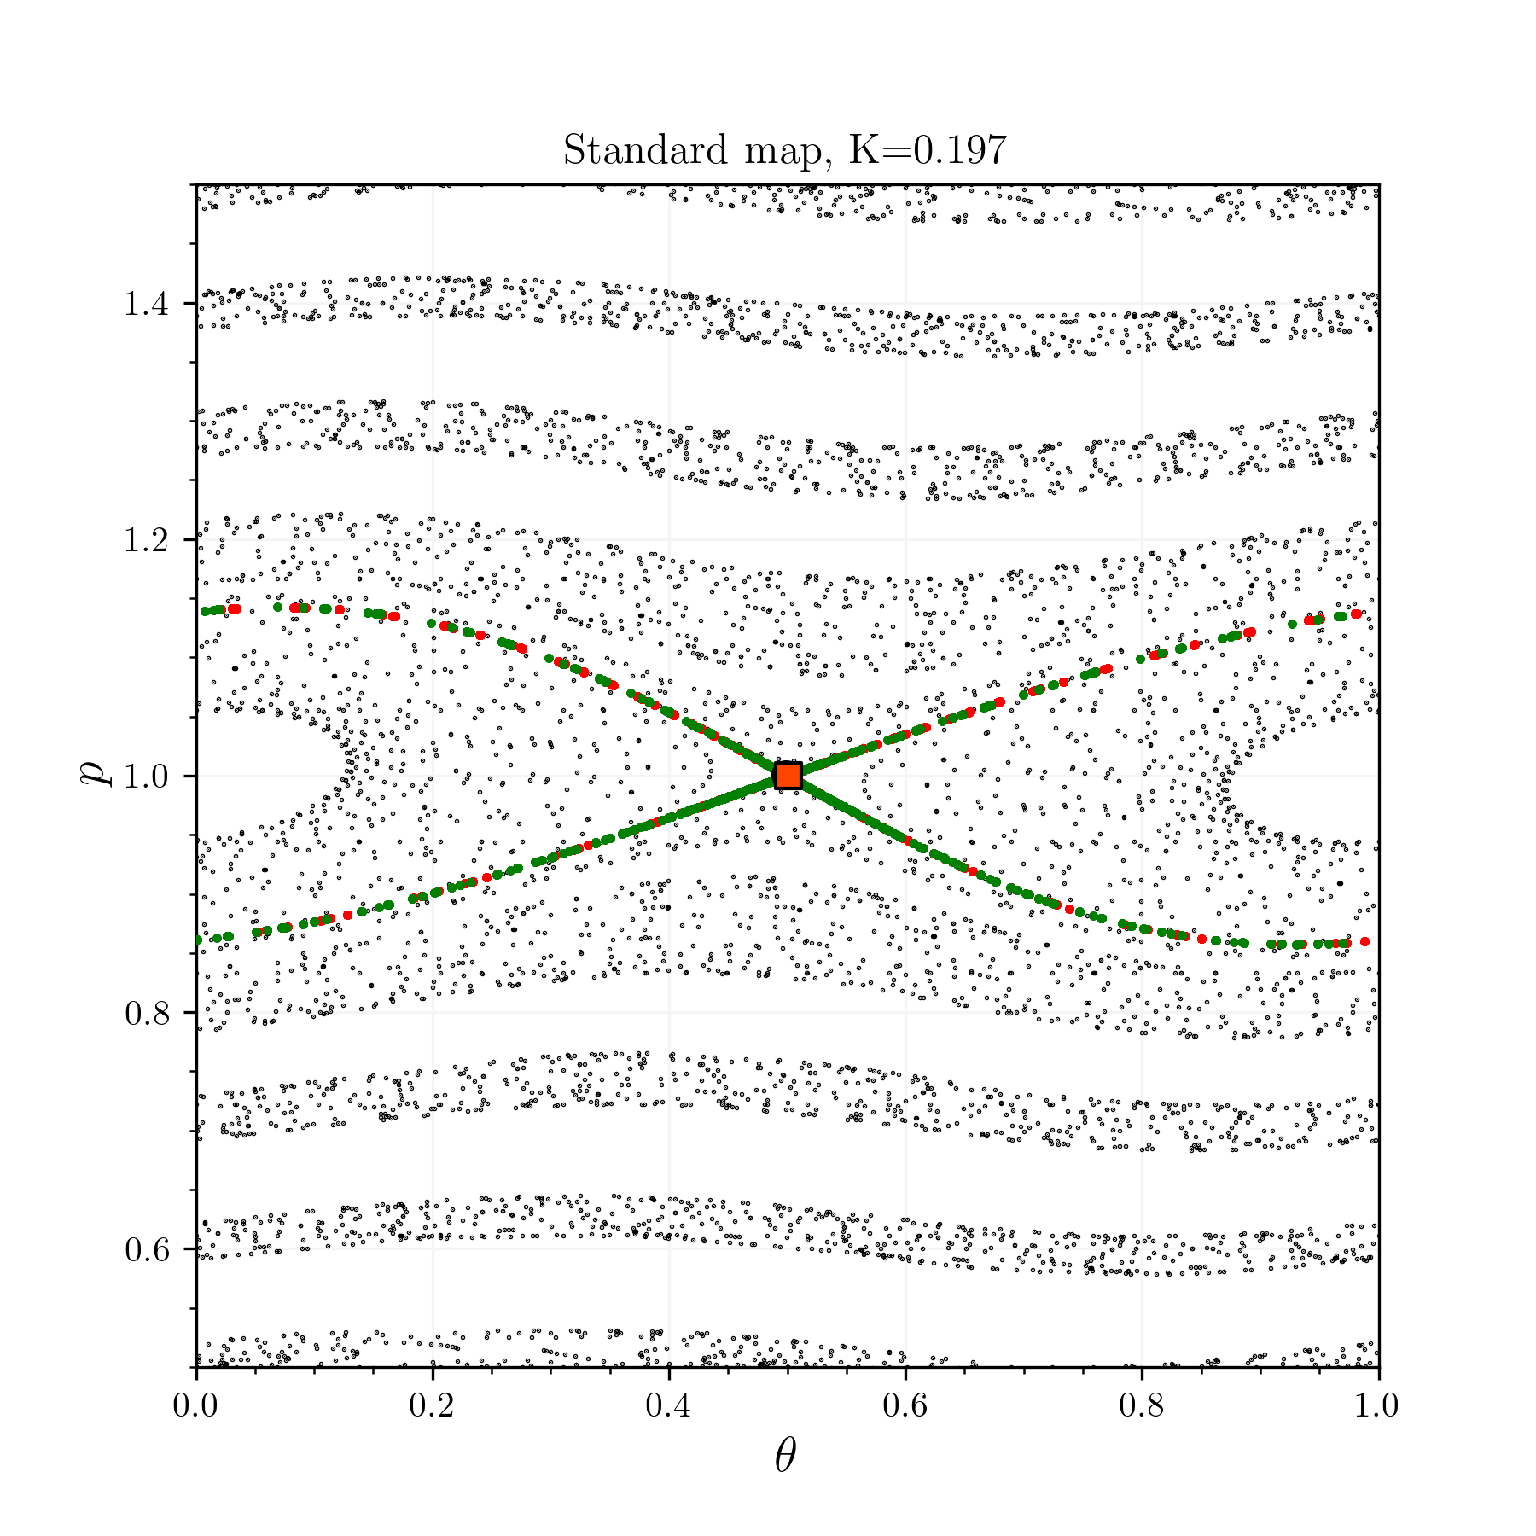

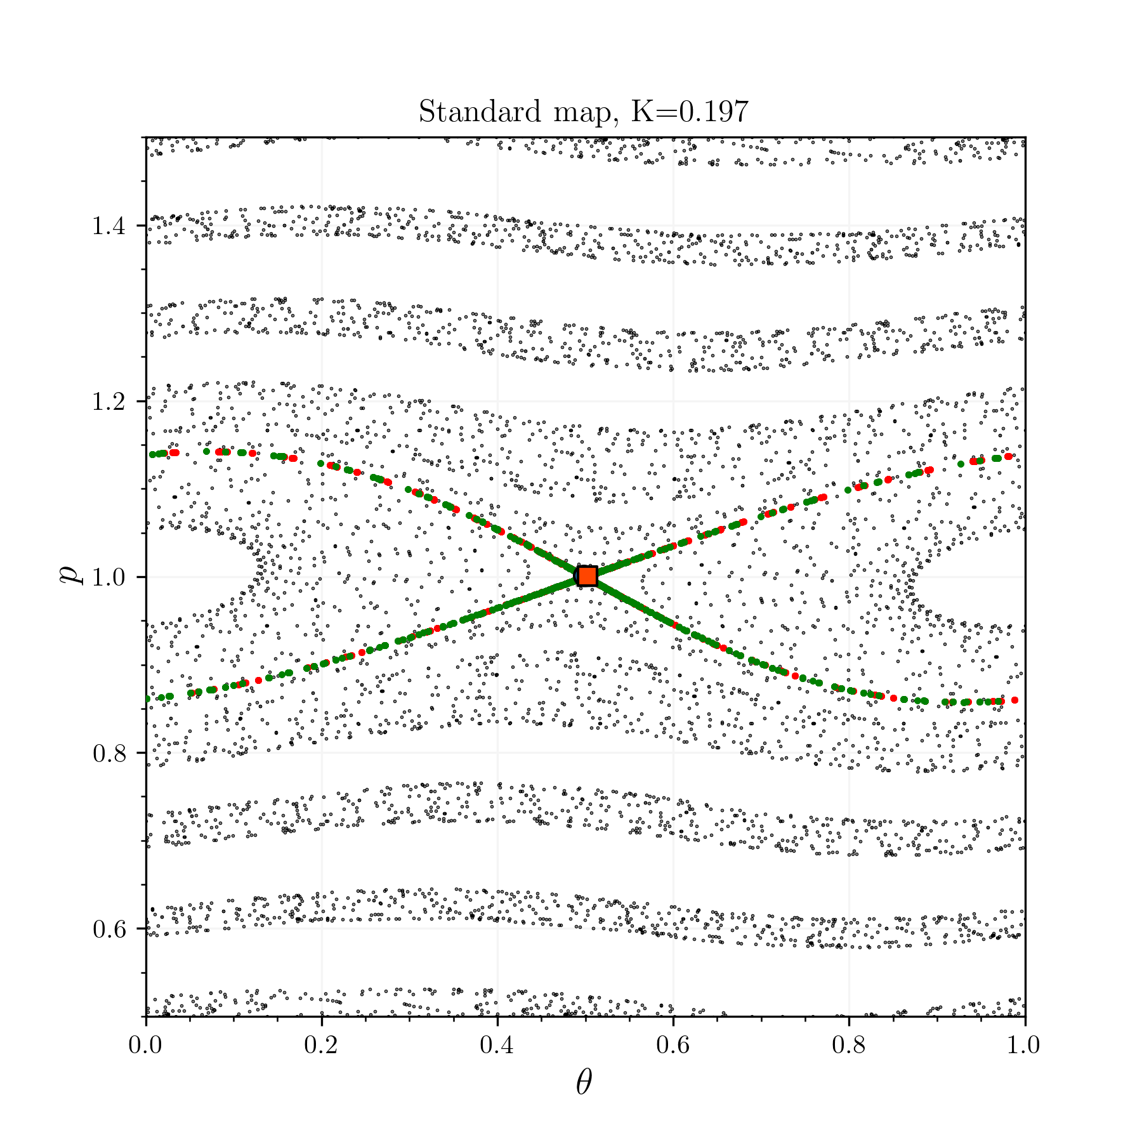

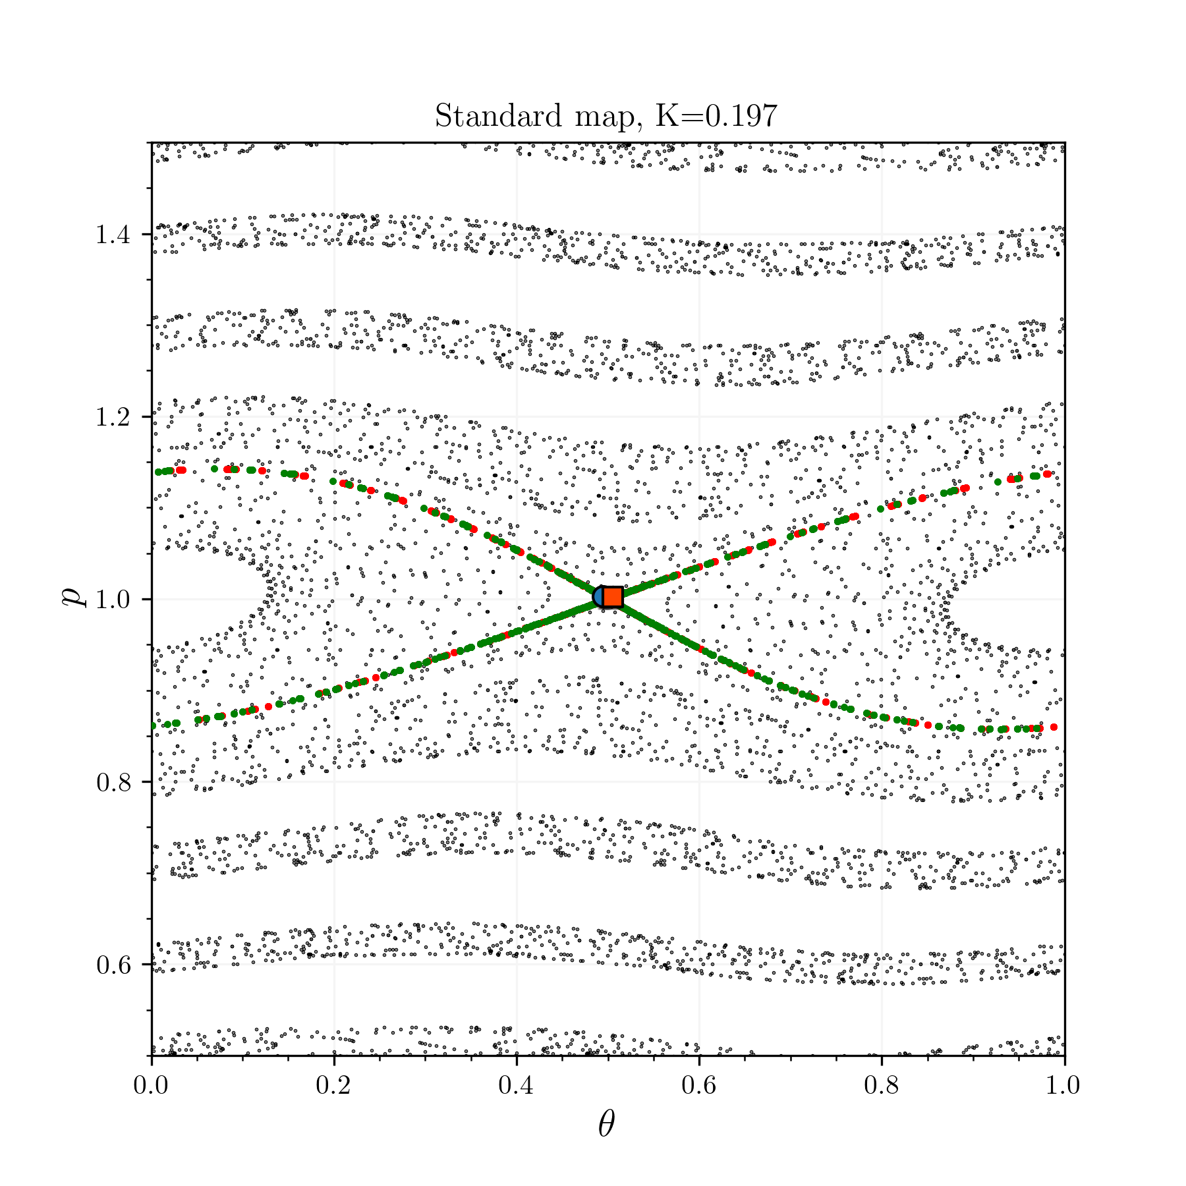

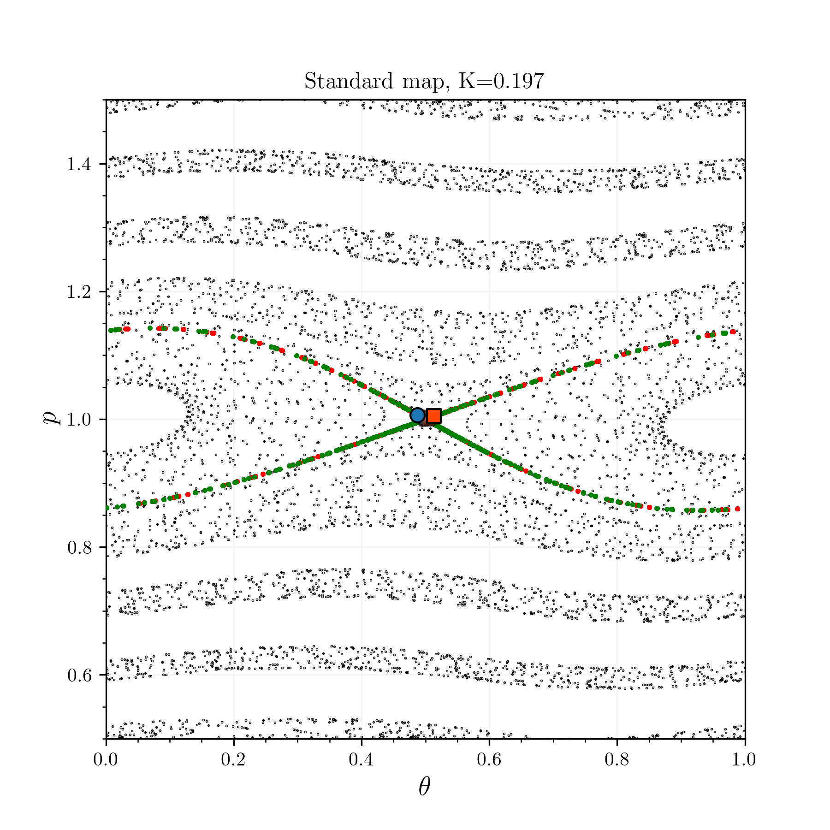
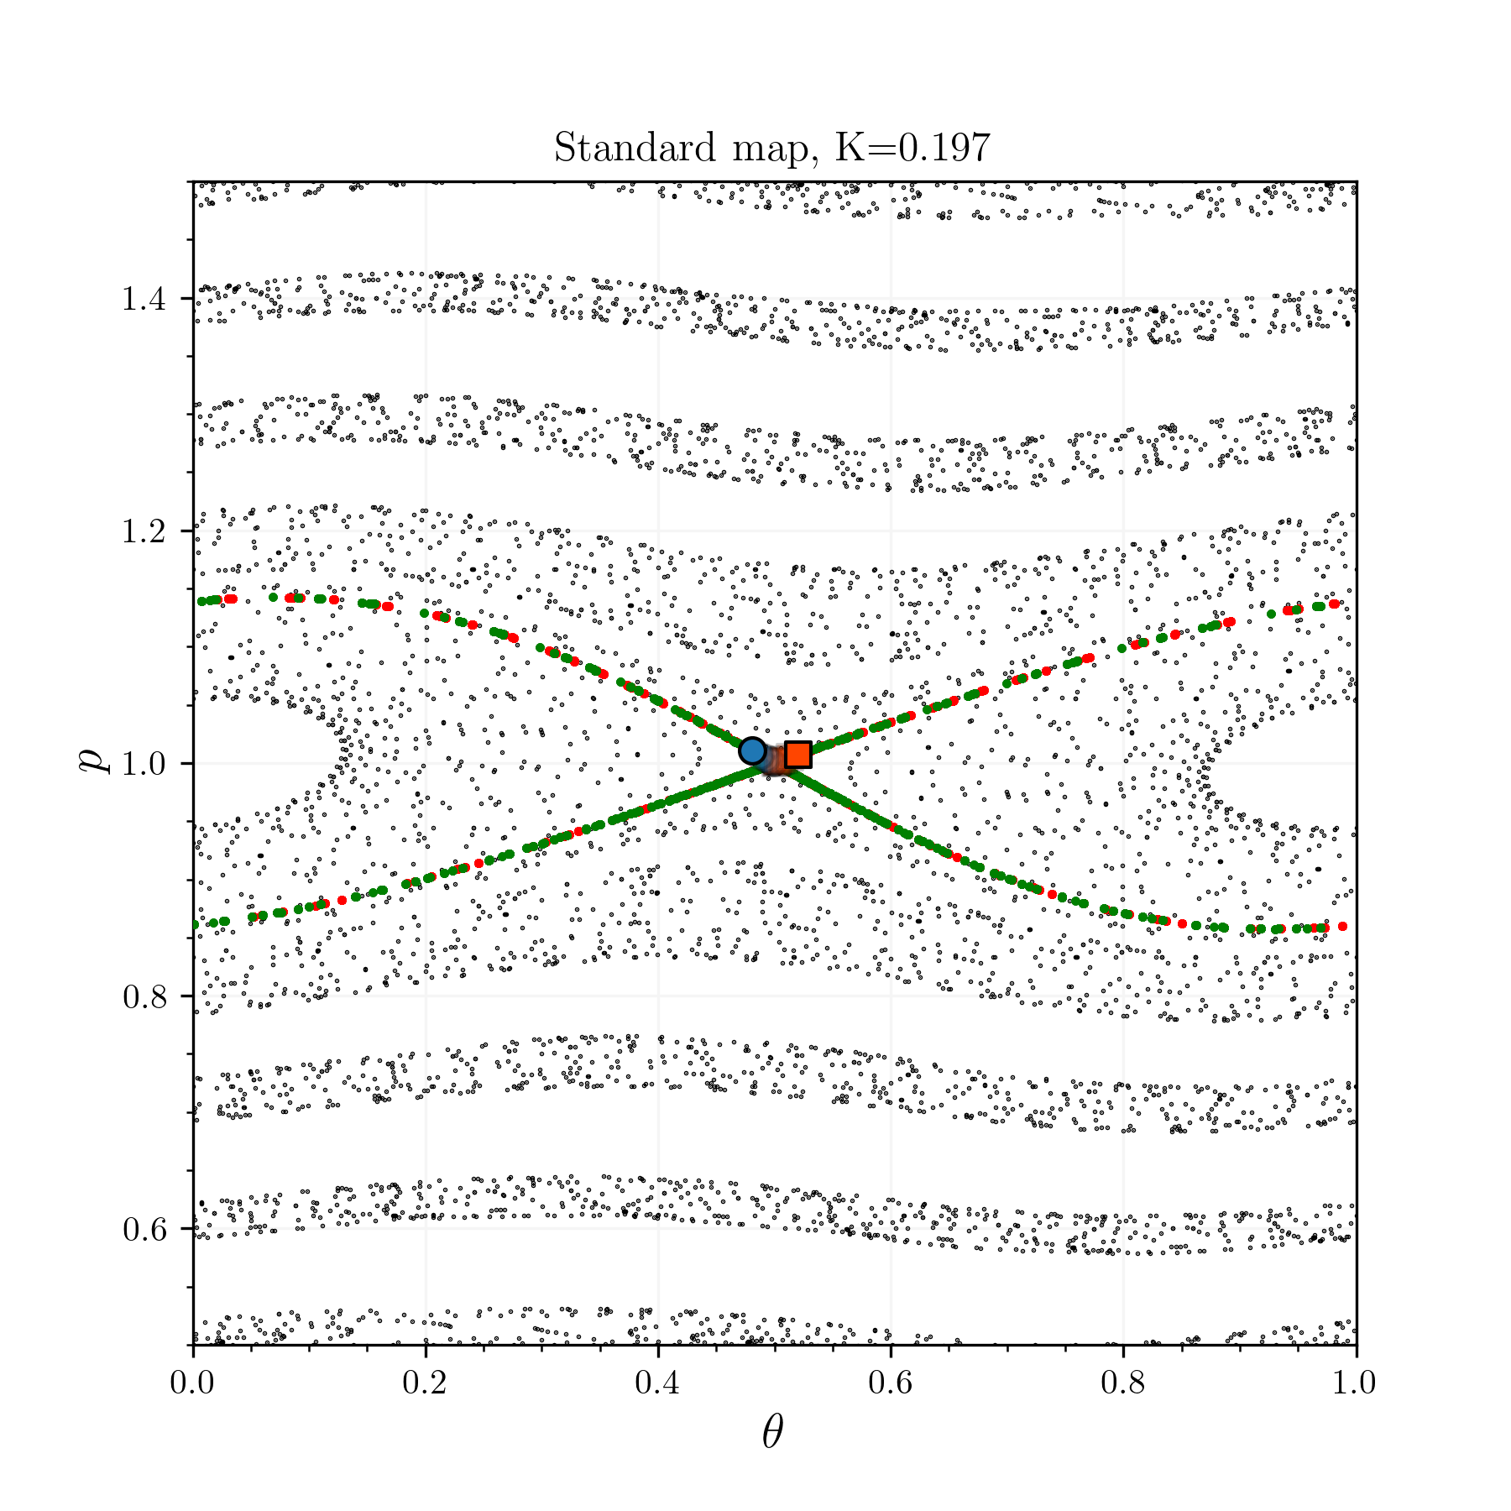
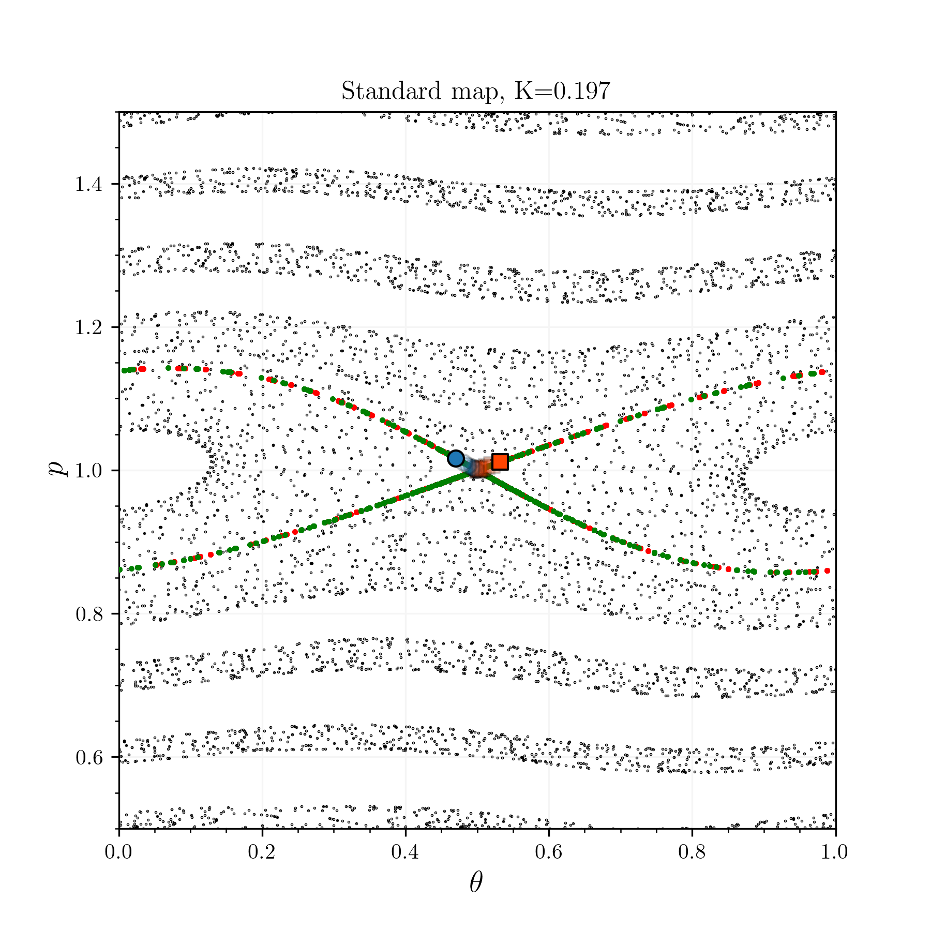
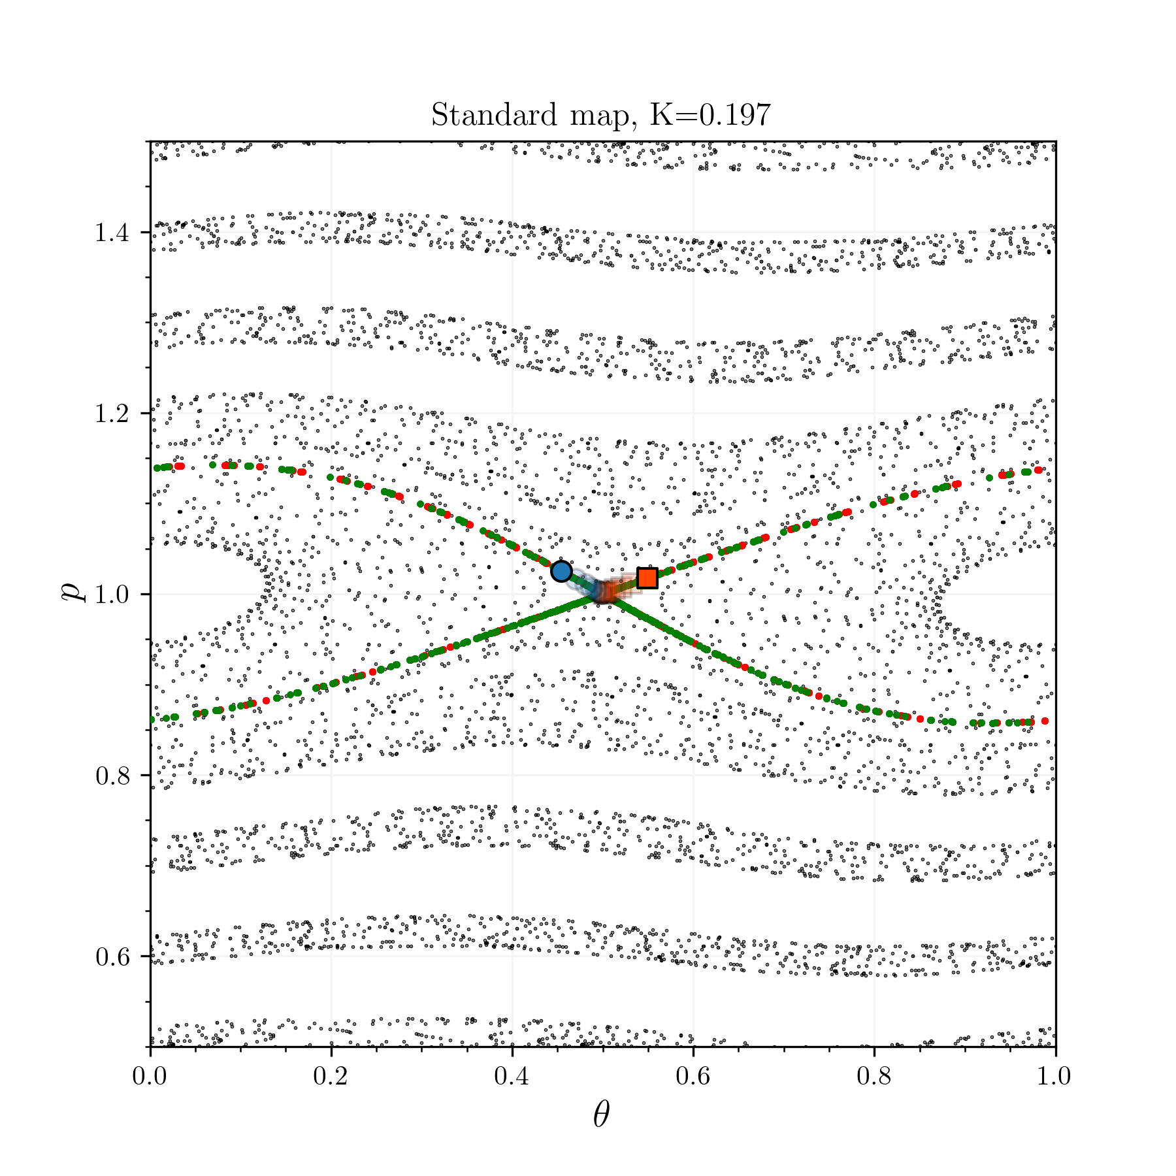
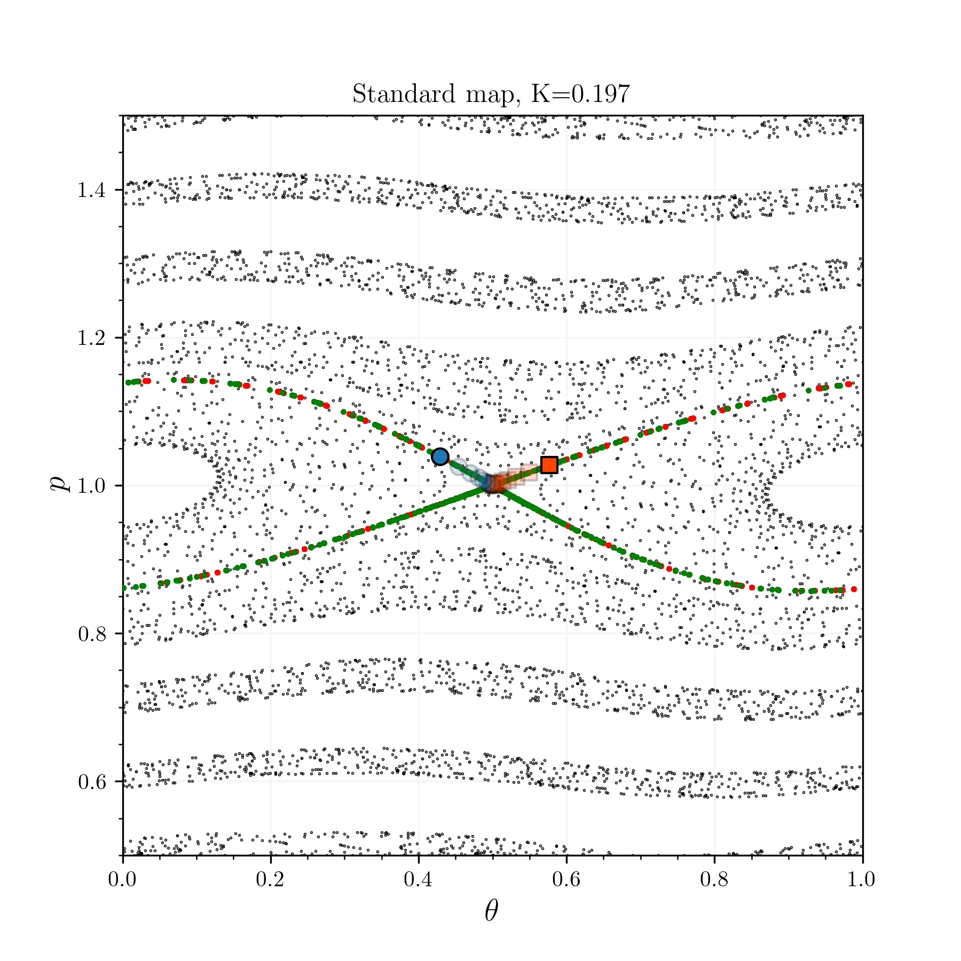
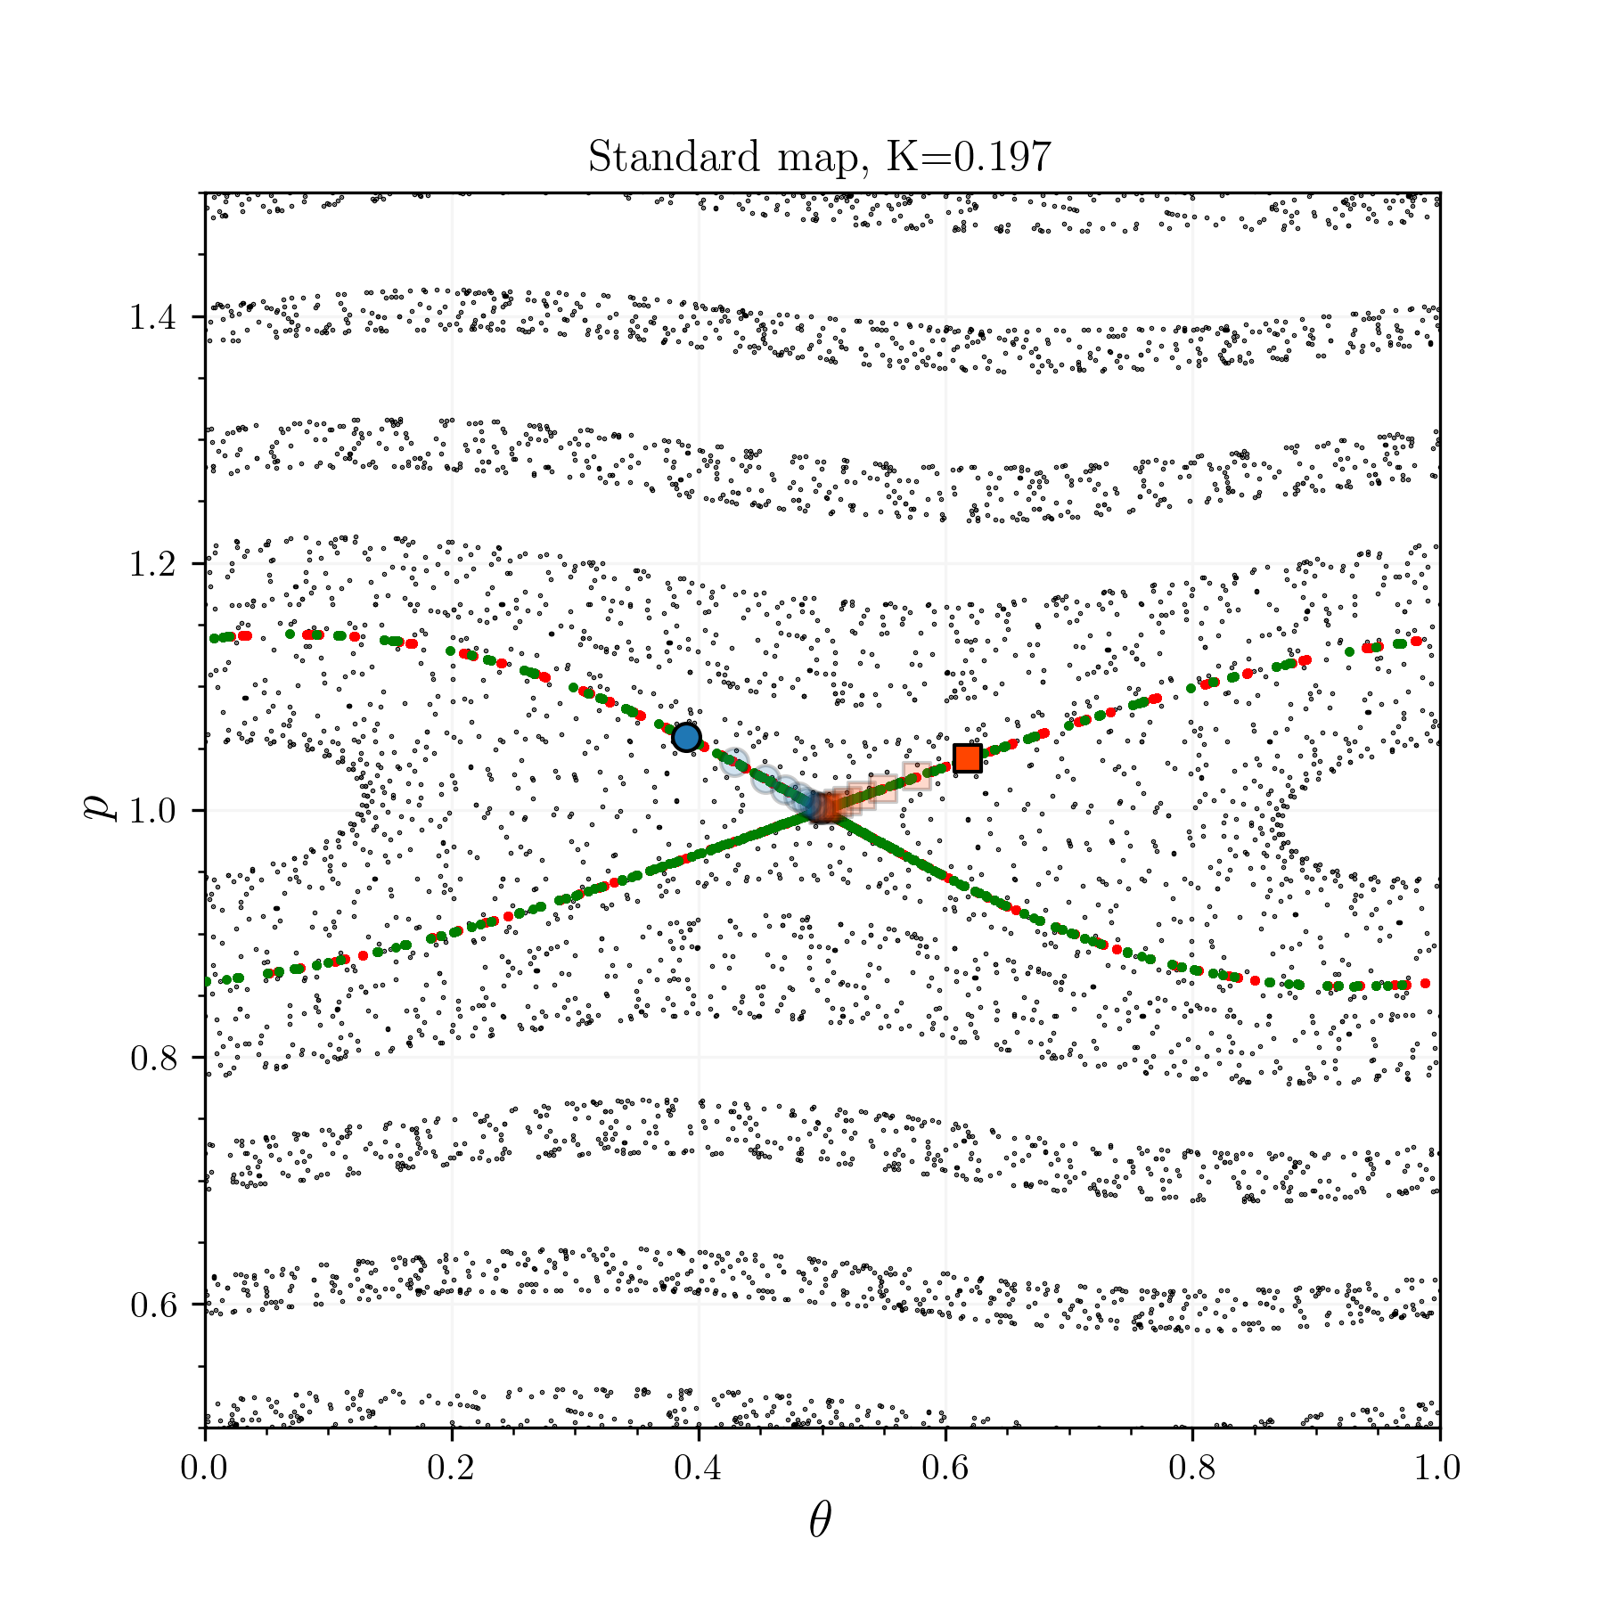
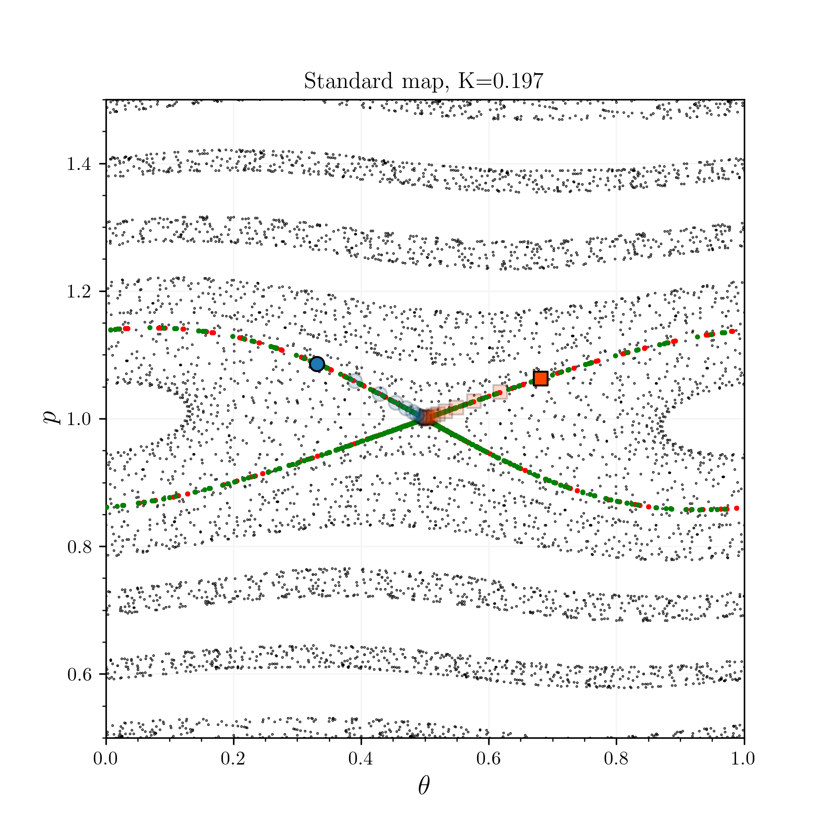



















Hyperbolic fixed points have a stable and unstable manifold
The jacobian indicates the behaviour of nearby lines
Calling the standard map $F$, and due to the area conservation, the determinant of its jacobian has to be one
For an elliptic point (O-points), $λ_{1},λ_{2}$ are complex conjugate and indicate rotation
For a hyperbolic point (X-points), there is a stable (${|λ}_{s}|<1$) and unstable ($|λ_{u}|>1$) direction
Initializing a point $x=x^{∗}+ε_{u}e_{u}$ and apply the map
Initializing a point $x=x^{∗}+ε_{s}e_{s}$ and apply the inverse map
https://champsproject.github.io/lagrangian_descriptors/content/chapter2_1.html
Notes:
If you find a fixed point and you want to know the nearby behaviour you look at the jacobian of the map.
Due to area preseration, you have that the determinant of the jac is equal to 1.

Slide 8















Unstable and stable manifold create a tangle structure when choatic
Manifolds are
Stable $W^{s}$: points converging to $x^{∗}$ as $t →+∞$
Unstable $W^{s}$: points converging to $x^{∗}$ as $t →−∞$
When the chaos appear, the unstable and stable manifold that were creating the separatrix separates
As we move on the unstable/stable manifold back towards the X-point they gets strechted out
The interconnection creates a grid structure with infinite number of intersections, resembling a trellis (H. Poincaré, Les méthodes nouvelles de la mécanique céleste. Ch.31)
Notes:
What if we have chaos now ?
Let’s increase K.
Definition
Separates
Get streched
INTERCONNECTION

Slide 9




Intersection of $W^{s}$ and $W^{u}$ are homo/hetero-clinic points
Heteroclinic orbit : points for which the forward and backward time evolution converge towards fixed points
If $x_{0}^{∗}=x_{1}^{∗}$ then referred to as a homoclinic orbit
In fact the space of heteroclinic points can be defined as
https://en.wikipedia.org/wiki/Homoclinic_connection
Notes:
Interested in points that both go to the fixed point in the forward and backward time evolution

Slide 10



Points in the intersection exit or enter the resonance zone
Points in the inside of the bounded region but in the intersection will end up outside
On the contrary points catched on the outside but in the intersection will end up inside
For flux/area preserving map, it implies that the entering flux is equal to the outgoing flux
Similar to a turnstile

Slide 11






























Trellis structure and turnstile behaviour explain why the brokeness is linked to chaos
Taking two close starting points inside of the resonance zone and manifold intersection
They start close but are still separated due to the infinitly thin grid structure
Thus after some amout of iterations they will end up in different region, no matter the initial their initial closeness.
How to compute this indicative turnstile flux for the poincare map ?
Notes:
See the relation to the Lyapunov exponents.

Slide 12








Introducing an analyitic high aspect ratio tokamak equilibrium
Introducing an analytic field in cylindrical geometry to facillitate the field line tracing, verify the latter calculations
Poloidal flux surfaces $ψ_{ }∝ρ^{2}$ for nested toroids
In the high aspect ratio $ε≫1$ approximation, the $q$-profile is quadratic with $ρ$
Adding the $A^{R}$ related to
Gives a $q$-profile
Wesson, Tokamaks.

Slide 13






Adding the field of a circular current loop to create an X-point
The vector potential of a circular current loop at position ${(R}_{l}, 0)$
where $E, K$are the complete elliptic integral of the first and second kind and
Substituting $Z$ for $Z−Z_{l}$ makes it general and then take
Simpson et al., ‘Simple Analytic Expressions for the Magnetic Field of a Circular Current Loop’

Slide 14






Adding perturbations
To see Chaos emerge, a perturbation field is required
Noting the angle periodicity in toroidal coordinates
Maxwell–Boltzmann and Normal distributions for $A^{i}\left(ρ\right)$
Adding an $ψ_{pert}=R^{2}A_{pert}^{φ}$ Maxwell-Boltzmann with the $m/n=6/1$to target the edge
Notes:
Here note that rho and theta are the simple poloidal coordinate in the plane and not the straight field line, thus m and n are not directly the mode perturbation. However Chaos appears faster, which is a desired feature

Slide 15






Poincare sections of the ToyTok with perturbations

Slide 16















Tracing the manifold for the poincare map
Adapting the computation for the poincare map
$x=x^{∗}+ε_{u}e_{u}$ and forward integration
$x=x^{∗}+ε_{s}e_{s}$ and backward integration
Initializing points between $x$ and $𝒫\left(x\right)$
Notes:
The closer you are to the fixed point the , why exactly we have this behaviour change and we need even spacing in exponential space

Slide 17
















Finding a homoclinic point by searching for a root
The intersection of the stable and unstable manifold are homoclinic points, they come back to the X-point
In this context, we say that homoclinic points differ if they are not in the same orbit. There must be at least two different homoclinic orbit
Set a starting point on each manifold
Find a tuple of forward $n_{u}$ and backward iteration $n_{s}$ such that the point cross each other
Minimize the resulting difference
Thanks to Matt Landreman for the general idea

Slide 18


Some ToyTok configuration have more than two homo/hetero-clinic points

Slide 19





Using the same algorithm with different initial guess to find the other homoclincs
Once a first homoclinic has been found, all remaining $n_{h}−1$ homoclinics have to be in the initial segments
The intervals are parcourred in opposite directions
If we write $ε_{s}^{1}$ the end of the stable initial segment and $ε_{u}^{1}$ the beginning of the unstable initial segment, then we choose
And try again to find the root of
Notes:
Can be difficult, for random field you don’t know a priori the number of intersection

Slide 20





Meiss’s action principle provides a way to calculate the turnstile area for the standard map
As mentionned, the standard map preserves the area, now we write the area as
Then use Stokes theorem on $R$, which has as boundary
Finally using the exactness property we can write those integrals as an infinte some of an associated lagrangian function evaluted at the heteroclinic points
Meiss, ‘Thirty Years of Turnstiles and Transport’.

Slide 21















Turnstile flux is computed by integrating $A$ along a specific path
How to calculate the flux $Φ_{lobe}$ through the surface $Σ_{lobe}$
Take the curve $γ_{0}$ which is part of the unstable manifold and do one forward iteration. It brings it to $𝒫(γ_{0})$
The boundary of $Σ_{lobe}$ is
The flux on the $Σ_{ev}$ surface is null because $B$ lies in it, and therefore
with $Γ=γ_{0}+γ_{1}$+ $γ_{2}$+ $γ_{3}$
The $γ_{1}$ and $−γ_{3}$ describe are the trajectory of homoclinic points
Notes:
Why not directly just one ? For high m it will take a lot of time ? In the end it is a tradeoff of error on the integrator, time and number of points that we can have

Slide 22










Recursively applying the map reduces the remaining integrals to zero
The flux is conserved, same flux through $Σ_{lobe}$ as through ${𝒫^{k} (Σ}_{lobe})$ for any $k$
Taking $γ_{0}$ mapping it backward will make its length go to zero
Similarly taking $γ_{2}$ mapping it forward will have a same effect
Therefore, as the integrals are bounded, they converges to zero
Notes:
Instead of finding the difficult curve, integrating one single field line. So to wrap things up, instead of finding these complicated gamma 0 and gamma 2, we have to calculate a dot dl (the action) along only two trajectories. Or in fact as much you have clinic points. It is related to the sum presented in the standard map case as it converges to
Currently

Slide 23
















The calculation of the turnstile flux converges

Slide 24





Turnstile flux value is verified by simple approximations
The calculated flux is $Φ_{lobe}={\text{−3.8899}∙10}^{−1}$
Taking an estimation of the error due to the non consideration of the joining integrals
From one iteration to the next : $5.7{∙10}^{−4}$
By a evaluating the $A∙Δl$ at the mid point : $4.16{∙10}^{−5}$
Approximating the flux by
Estimating the area by a simple triangle
Estimating the area by the shoelace formula (area of a polygon by triangulariztion)

Slide 25






Amplitude scan
Notes:
Amplitude cannot really be related directly

Slide 26















For islands the manifolds link different fixed points and have inner and outer turnstiles
Toybox quadratic $q$-profile with a $m/{n=3/2}$ perturbation
There is a tangle structure on the inside and one on the outside
Four heteroclinic points
Turnstile calculation gives

Slide 27





QUASR, an open source database of stellarartors
Andrew Giuliani, Flatiron Institute (NYU)
Optimized for volume quasi-symmetry : QA and QH
Quasr database contains over 320’000 coil sets
Ability to fine tune the search and select disered configurations
Notes:
https://quasr.flatironinstitute.org/ I really recommend you to have a look at it if you haven’t already, It is really cool.

Slide 28




QUASR #0229079
Notes:
Here we see that there are many small islands in the edge

Slide 29








QUASR #0229079
Notes:
m = 12, n = 6

Slide 30




QUASR #0928241

Slide 31








QUASR #0928241
Notes:
Really quick fix that we can do to make the algorithm better, don’t try to map it endlessly but just wait that you are in the linear regime then take a segment joining the two point and evaluate A dot dl !

Slide 32
















Back on W7X-GYM00-1750 to caculate the turnstile flux

Slide 33




Connection lenght is explained by the turnstile
Notes:
This is a non rigourus proof.

Slide 34



Stochastic transport due to difference between inner and outer turnstiles
Inner and outer turnstile fluxes have different values, the inner one is lower
The difference in turnstile flux induces transport
From the inside, longer to go inside the island due to the low inner turnstile flux
Once inside however, not long until the field line leave due to the higher outer turnstile flux

Slide 35

Next steps
Apply the method in stellarator optimization
Reducing the chaos in the LHD edge, coordination with Todd Elder
Find different chaotic configurations by changing the currents in existing stellarators
Relate the turnstile flux to relevant transport metrics
Find a robust method to identify all hetero/homo-clinic points
If you want us to look at the turnstile flux in your configuration, we're happy to help!
Suzuki et al., ‘Impact of Magnetic Topology on Radial Electric Field Profile in the Scrape-off Layer of the Large Helical Device’.
Notes:
I also realized yesterday that we don’t need to try to have a lot of point, this will make the calculation much better in the case of the quasr configuration with one big island which was creating the chaos.

Slide 36

Wrapping things up
We have developed a robust method of calculating the turnstile fluxes
Validated this calculation against a toy model
The first computation (to our knowledge) of turnstile area in stellarator geometry directly from coils
Explain the connection length by the tangle structure
Notes:
Not complicated algorithms overall but a combination of things that need to be used.

Slide 37


Linear regime lower bound
Due to integration errors the linear regime is restricted by a lower bound $ε_{lb}<ε≪1$

Slide 38


Finding many clinic points is a hard problem in general

Slide 39


Link between the flow map determinant and the divergence free field

Slide 40
Floer Homology
Nice papers !

Slide 41
Action principle in detail for exact maps
Symp
What is an exact map :

Slide 42
Flux form and the flux conservation

Slide 43
Symplectic maps
Symp
What is an exact map :

